Slide 1


Orientation of the Web-Based Monitoring System Users of the School MOOE Funds
Anthony B. Barrera and Charlene M. Gandullas​

Slide 2

AGENDA
The MOOE System
Registration in the System
Requesting Fund in the System
(SH Account)
Review and Approval of fund
transfer (SDO Account)

Slide 3
AGENDA
Confirmation of fund received
Creation of Disbursement Voucher and Printing
Voiding of Vouchers

Slide 4

MOOE WEB-BASED SYSTEM

Slide 5

WHAT IS MOOE WEBBASED?
A system that tracks the release, receipt, use, and reporting of school funds.

Slide 6
HOW DOES MOOE WEB-BASED WORK?
It provides real-time updates and monitoring of school funds.
It helps the DepEd comply with DLI 5.2.
It helps monitor the release, receipt, utilization, and reporting of school funds.

Slide 7
WHY IS THE MOOE WEB-BASED SYSTEM IMPORTANT?
It helps ensure that schools have adequate funding to improve their operations.
It helps improve the performance of teachers and learners.

Slide 8
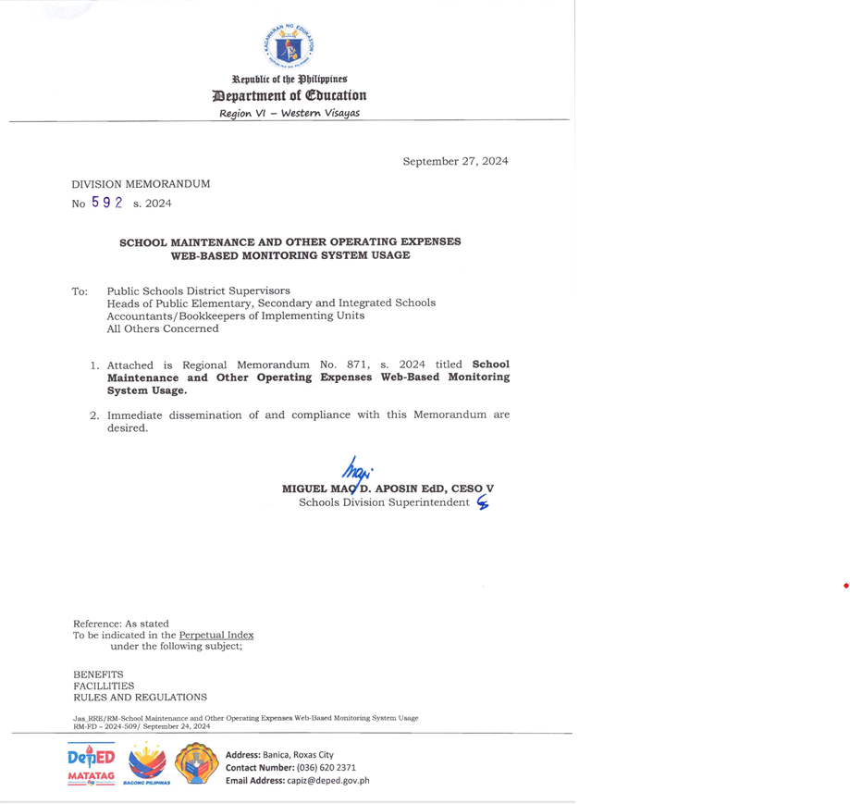
DIVISION MEMORANDUM NO. 592 s. 2024

Slide 9
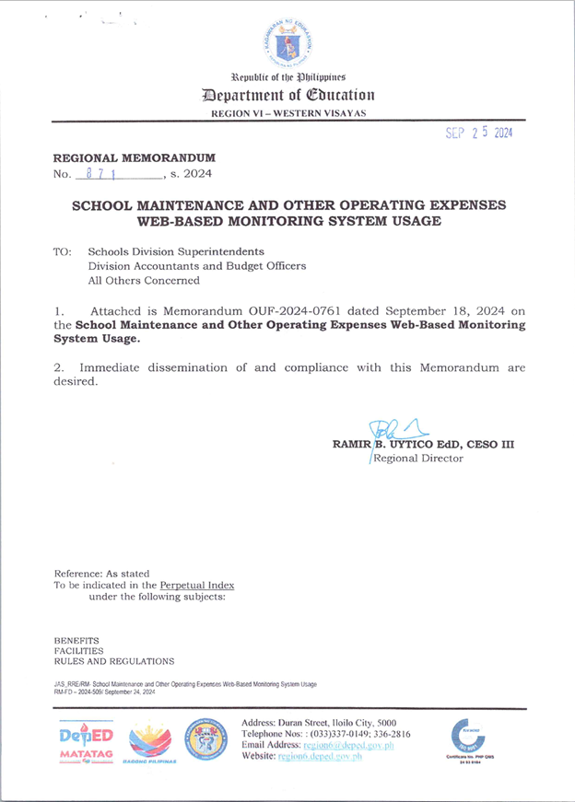
REGIONAL MEMORANDUM No. 871, S.2024

Slide 10
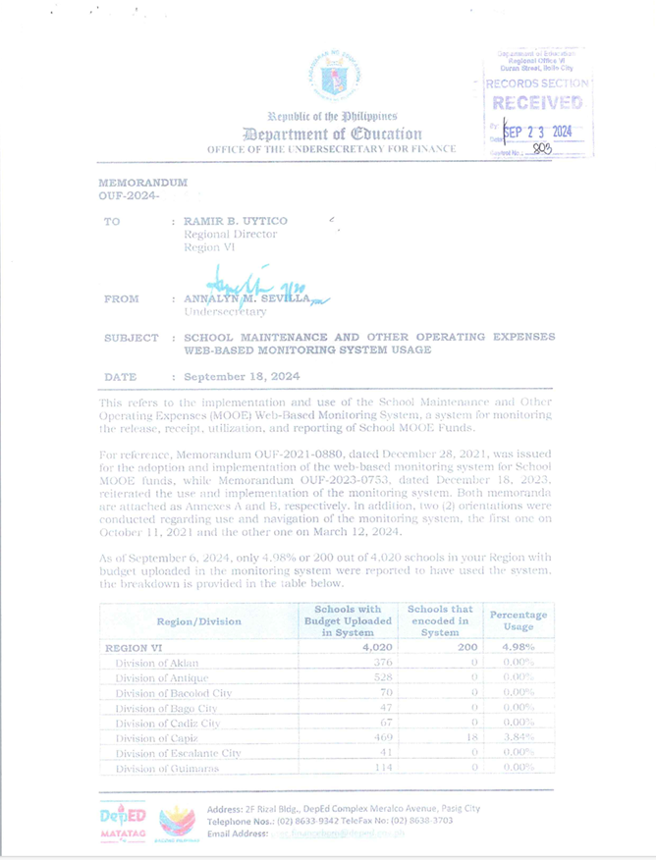
MEMORANDUM OUF 2024

Slide 11
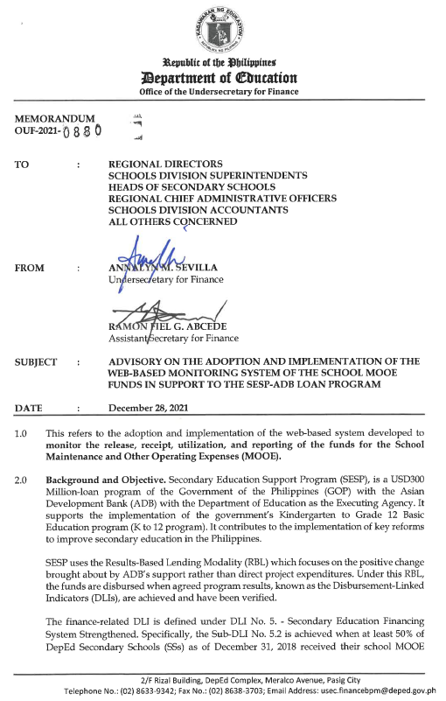
Memorandum (OUF) on the Adoption and Implementation of the Web-based Monitoring System of the SMOOE Funds

Slide 12

REGISTRATION TO THE SYSTEM

Slide 13

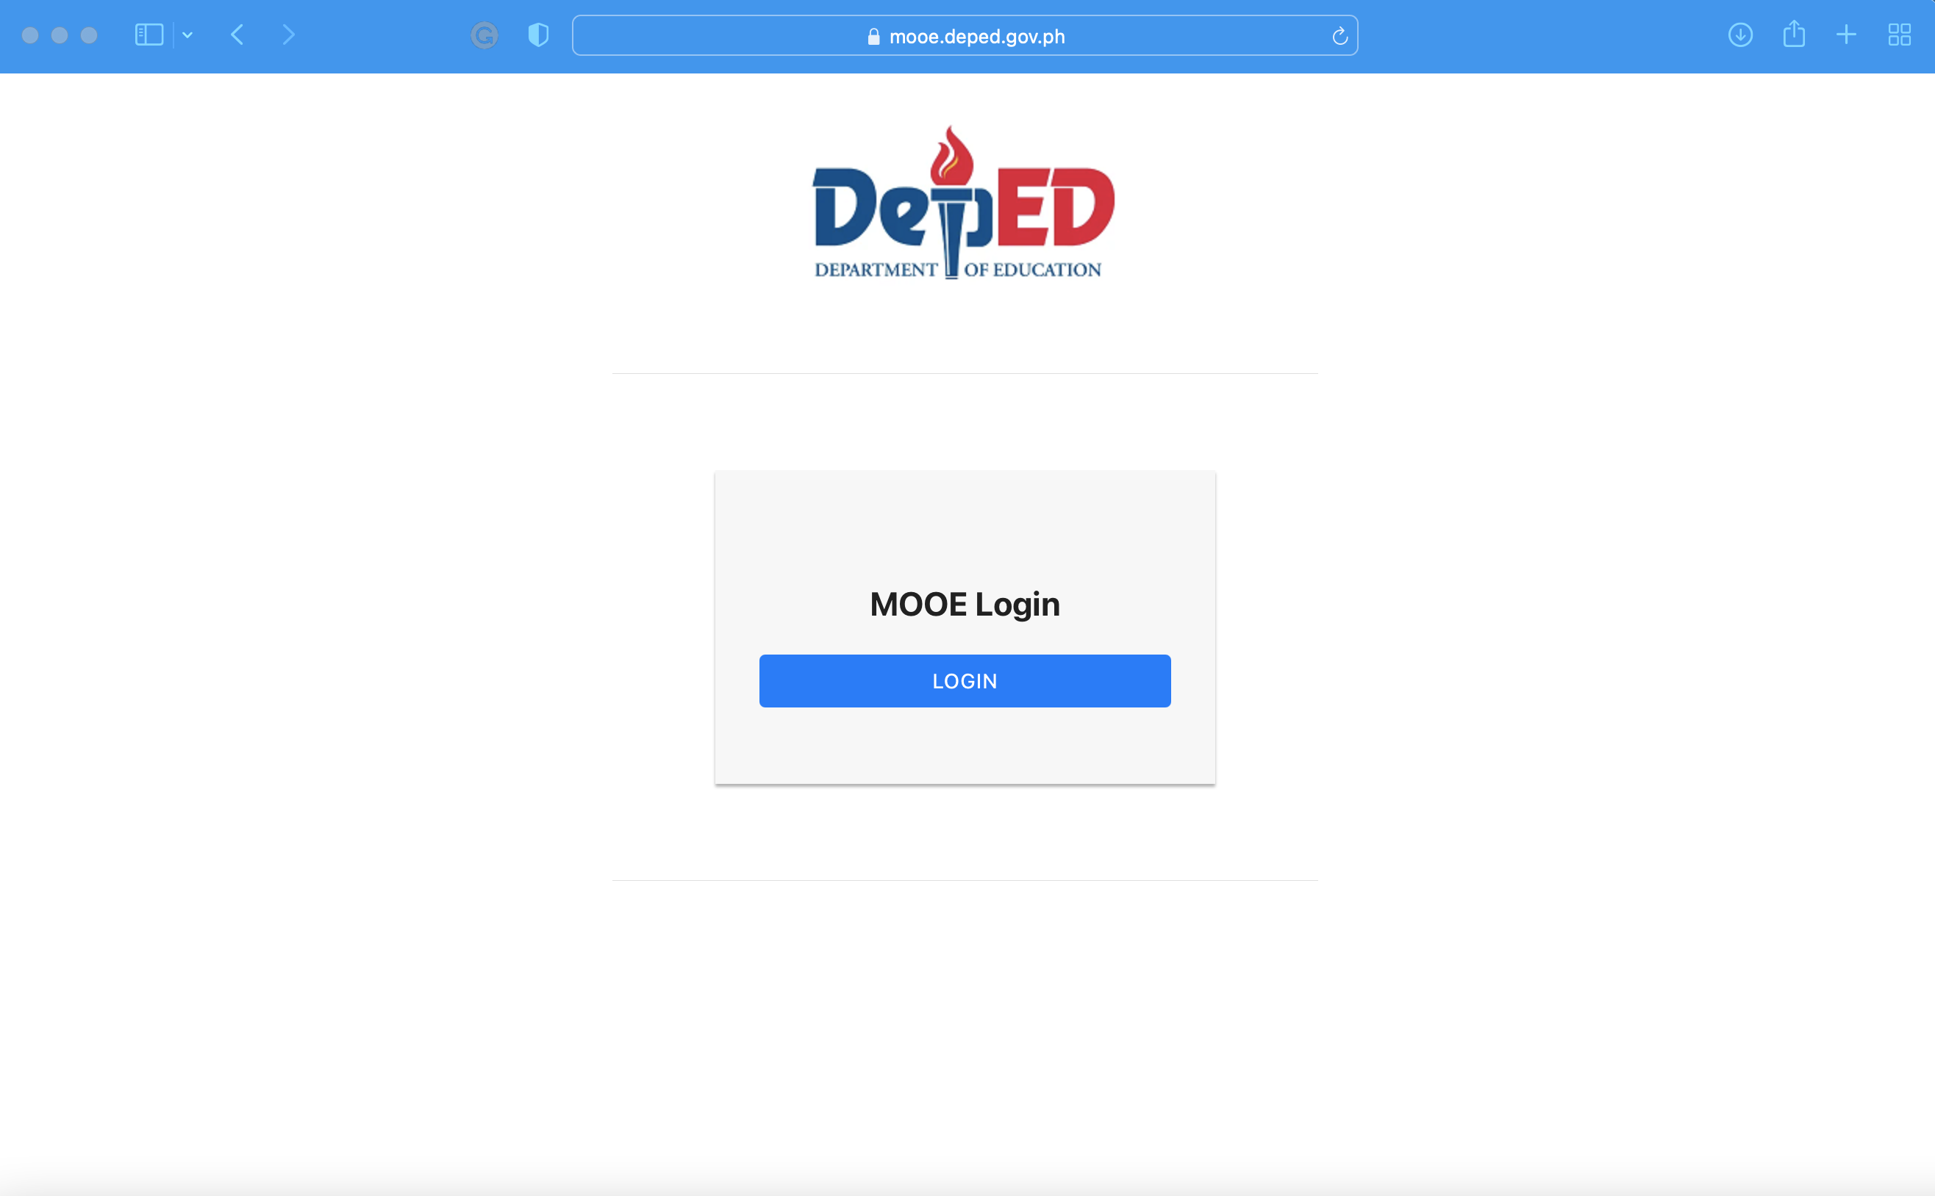
MOOE SYSTEM SITE/ LINK
https://mooe.deped.gov.ph

Slide 14
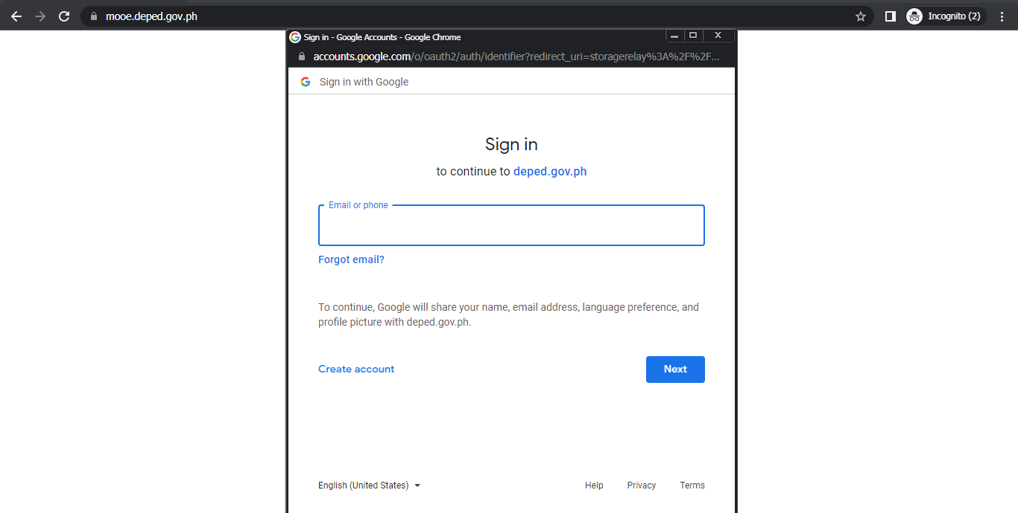
REGISTRATION IN THE SYSTEM

Slide 15
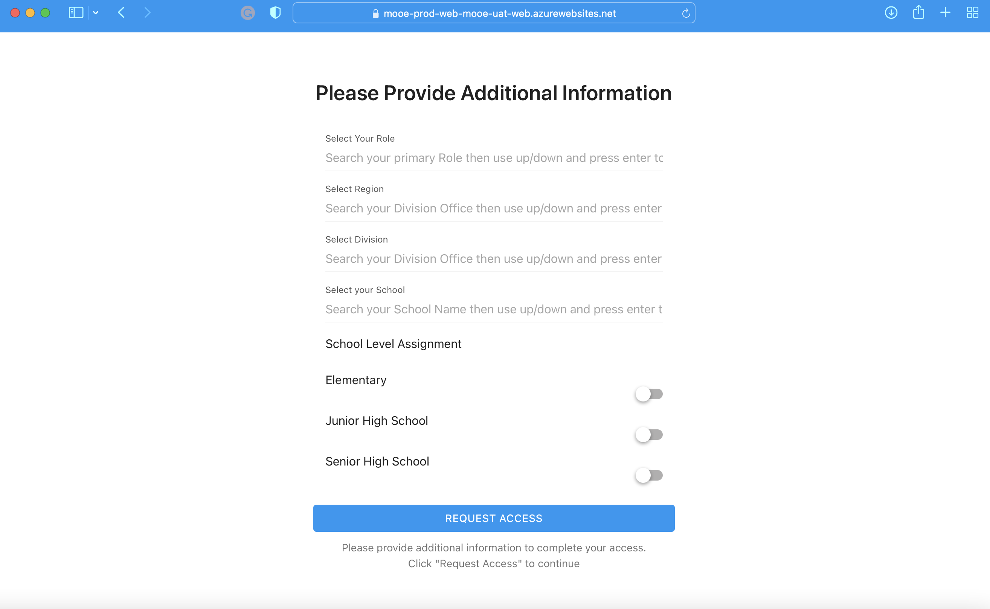
REGISTRATION IN THE SYSTEM

Slide 16
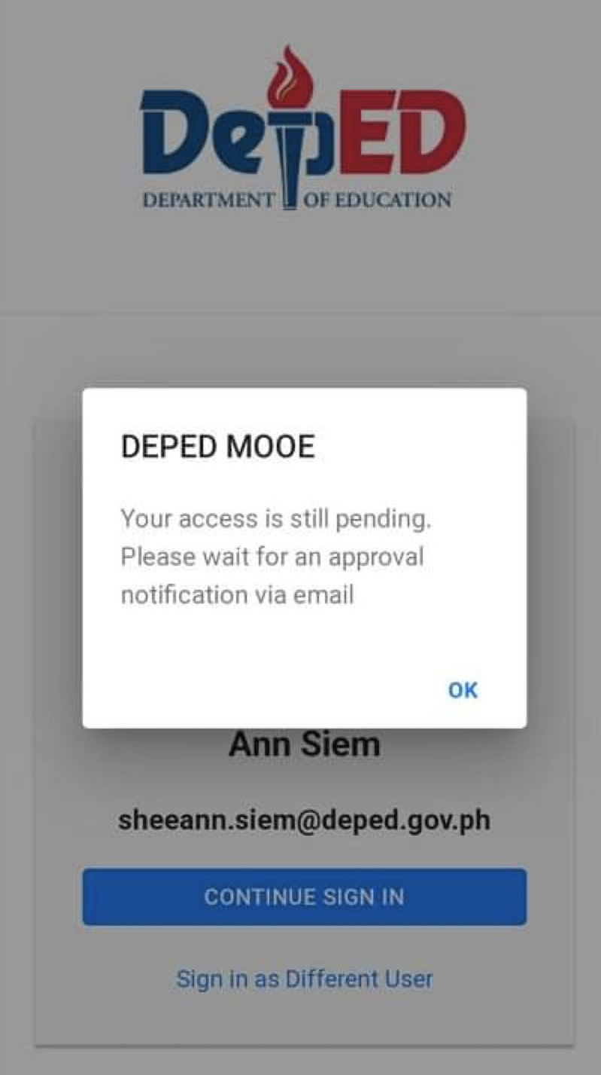
REGISTRATION IN THE SYSTEM

Slide 17
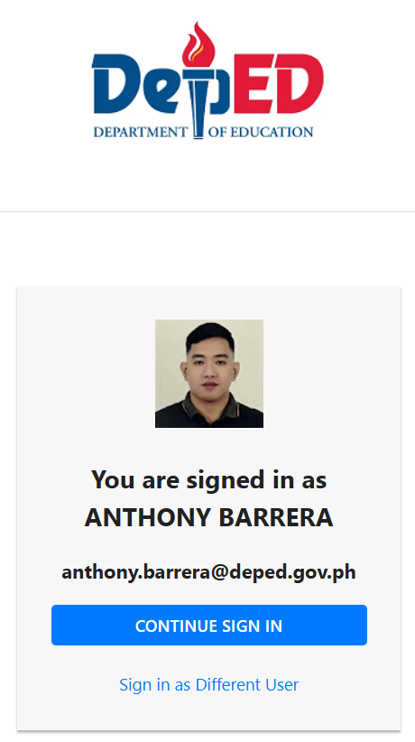
REGISTRATION IN THE SYSTEM

Slide 18

SETTING UP OF SCHOOL PROFILE AND BANK ACCOUNT (SCHOOL HEAD ACCOUNT)

Slide 19

UPDATING PROFILE

Slide 20
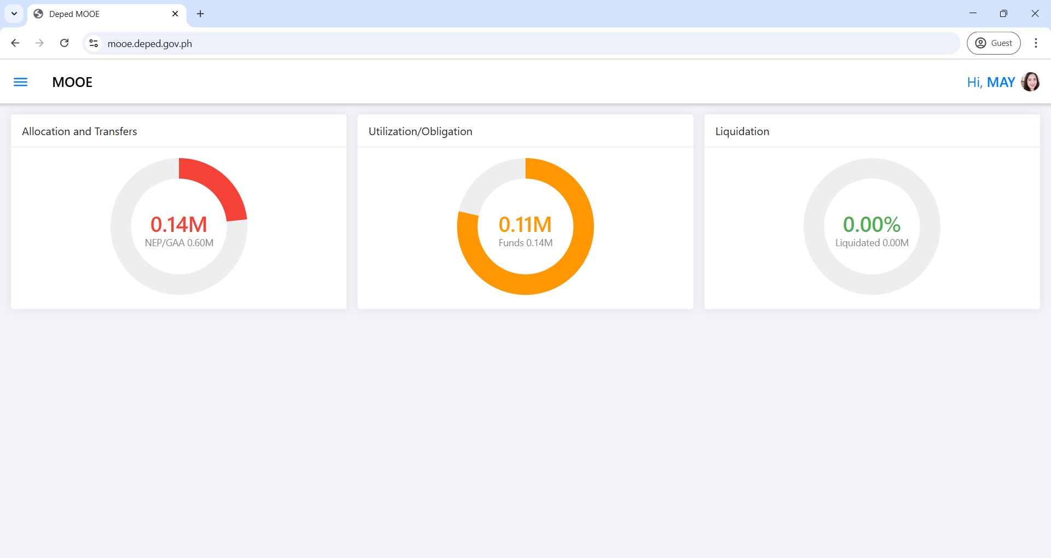
UPDATING PROFILE
(SCHOOL HEAD ACCOUNT)

Slide 21
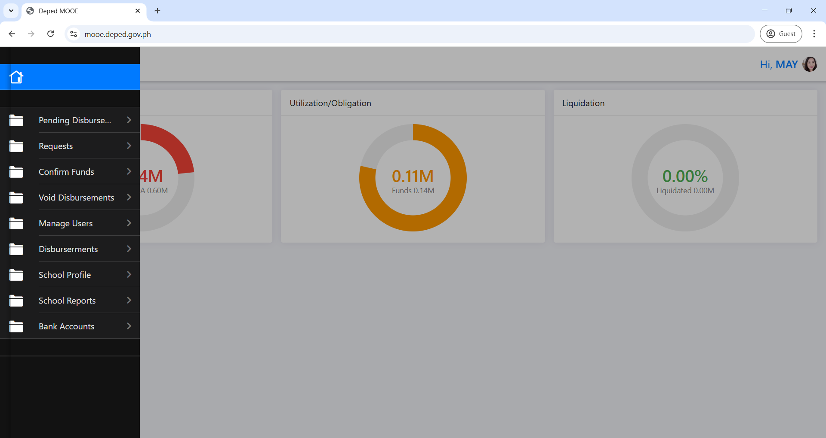
UPDATING PROFILE
(SCHOOL HEAD ACCOUNT)

Slide 22
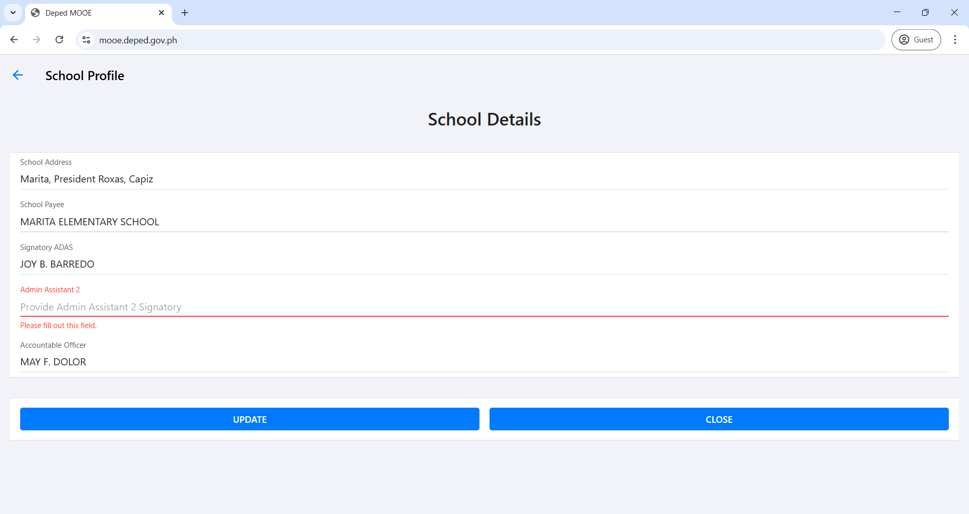
UPDATING PROFILE
(SCHOOL HEAD ACCOUNT)
Marie C. Gava
For those schools that has no ADAS, kindly encode here your SCHOOL TREASURER.

Slide 23
CREATING BANK ACCOUNT

Slide 24
SCHOOL HEAD ACCOUNT
(CREATING BANK ACCOUNT)

Slide 25
SCHOOL HEAD ACCOUNT
(CREATING BANK ACCOUNT)

Slide 26
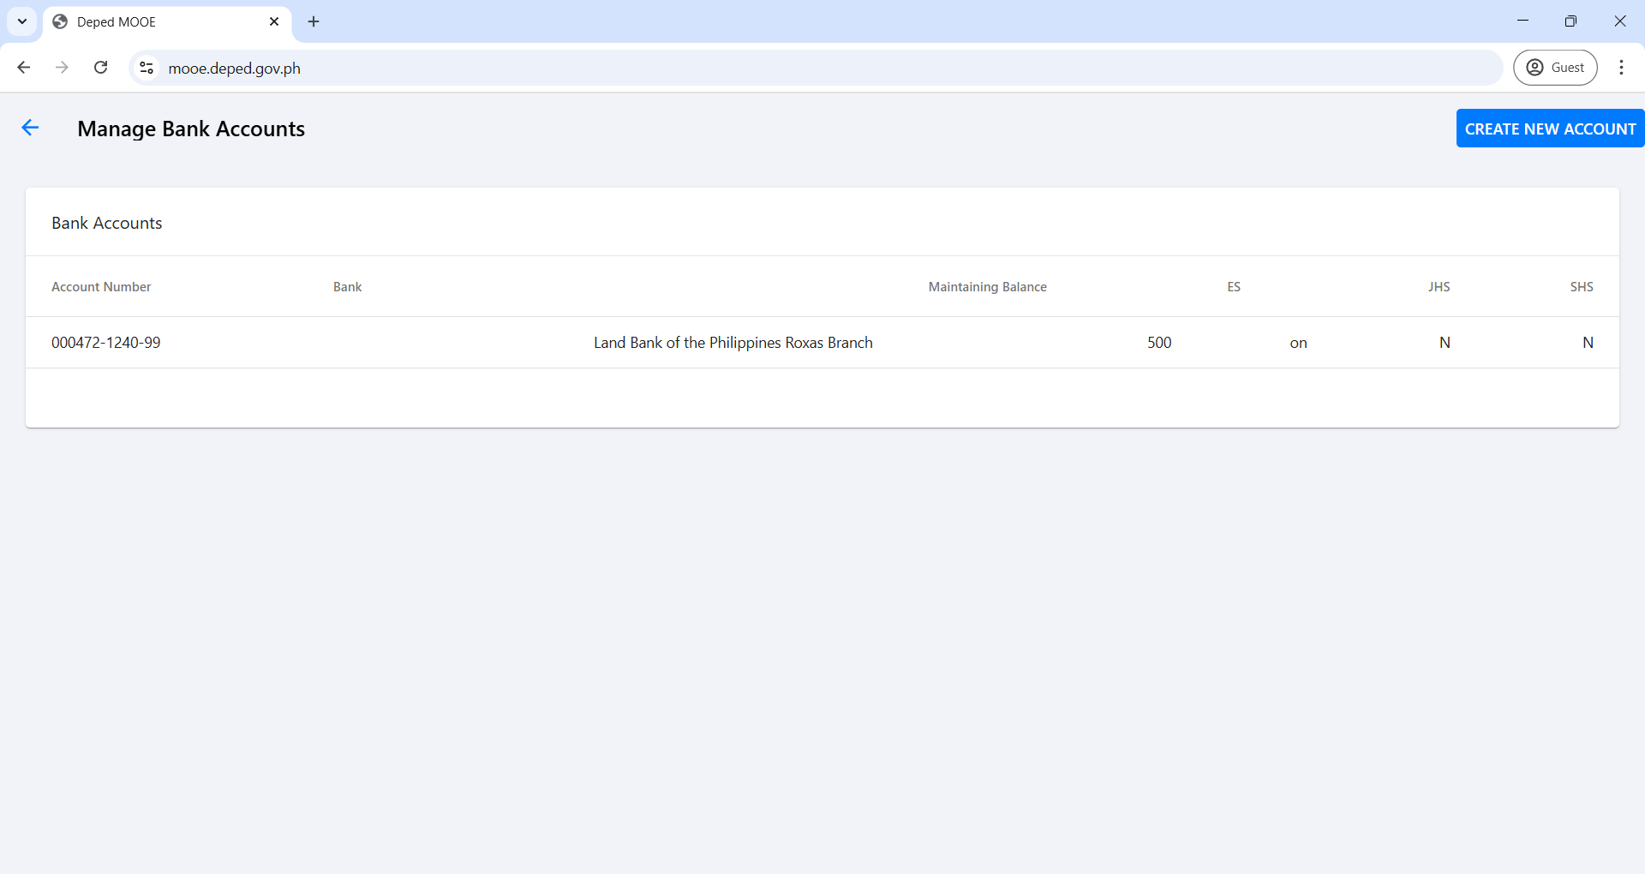
SCHOOL HEAD ACCOUNT
(CREATING BANK ACCOUNT)

Slide 27
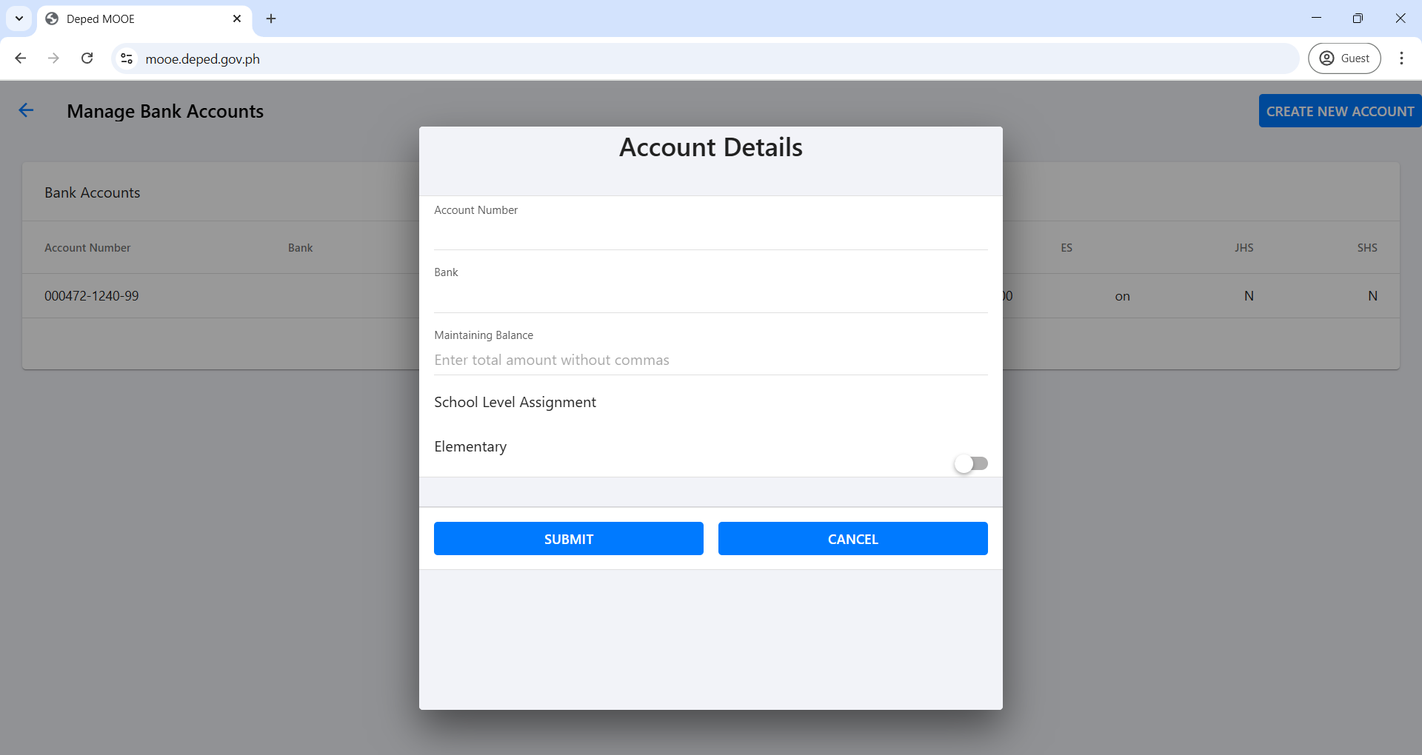
SCHOOL HEAD ACCOUNT
(CREATING BANK ACCOUNT)
1234-5678-90
Land Bank of the Philippines Roxas Branch
500

Slide 28
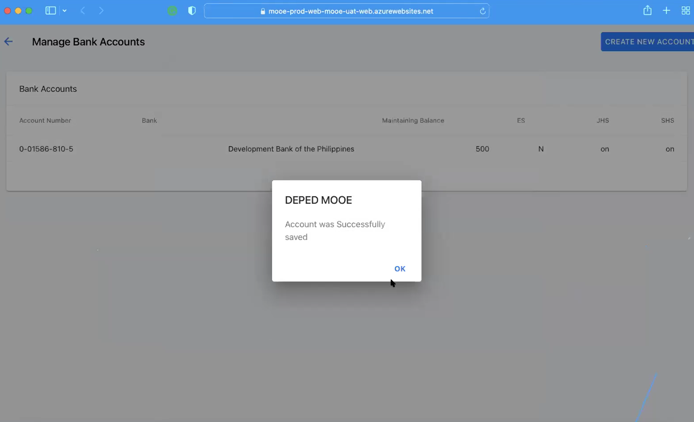
SCHOOL HEAD ACCOUNT
(CREATING BANK ACCOUNT)

Slide 29

FUND REQUEST

Slide 30

SCHOOL HEAD ACCOUNT
(FUND REQUEST)

Slide 31
SCHOOL HEAD ACCOUNT
(FUND REQUEST)

Slide 32
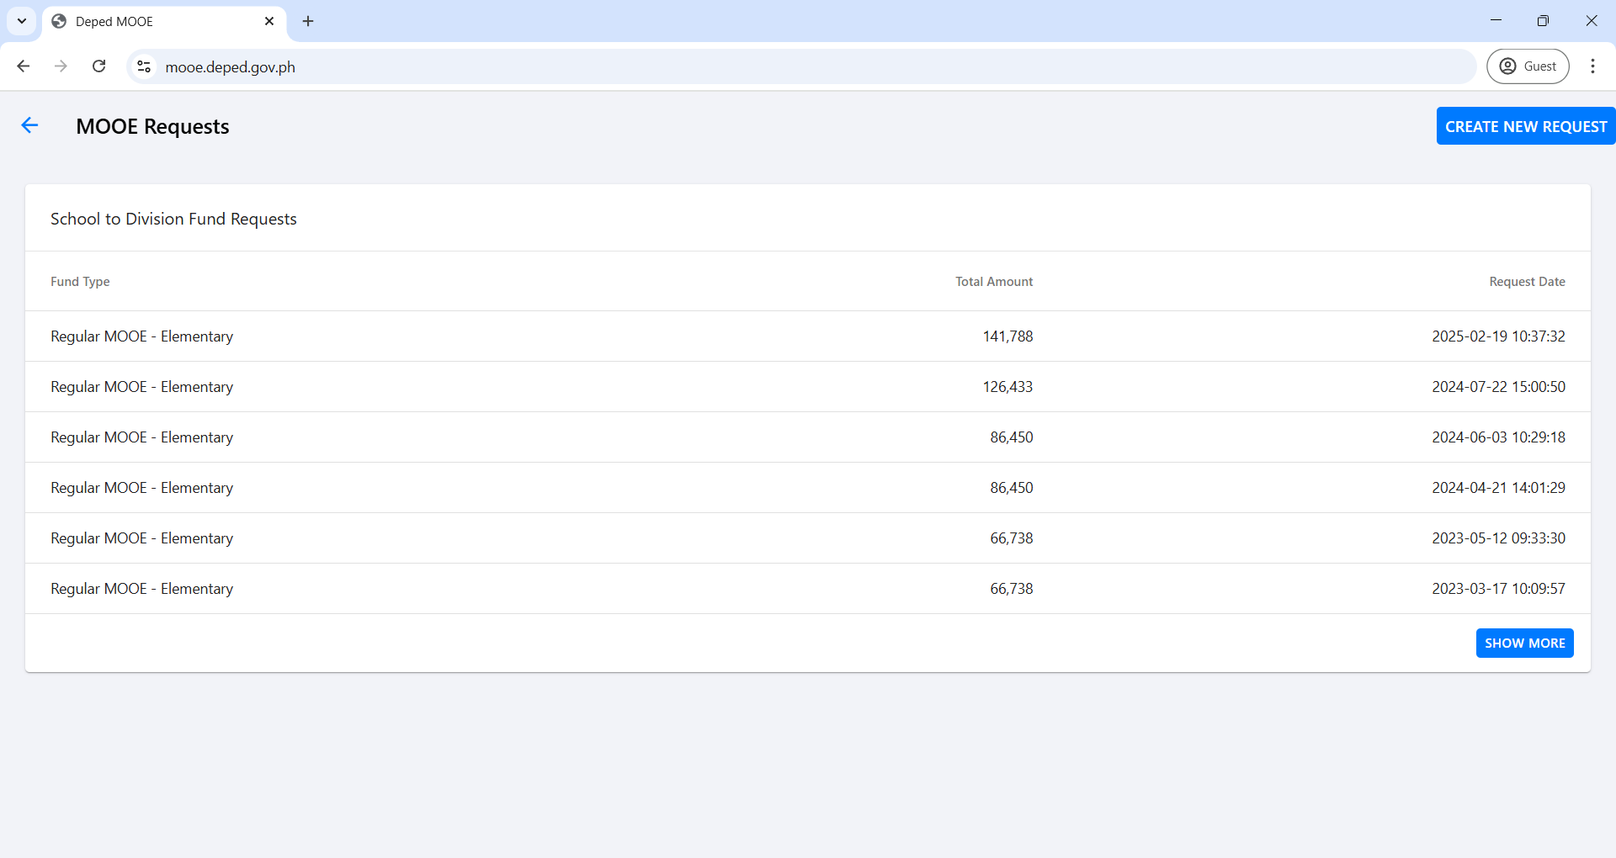
SCHOOL HEAD ACCOUNT
(FUND REQUEST)

Slide 33
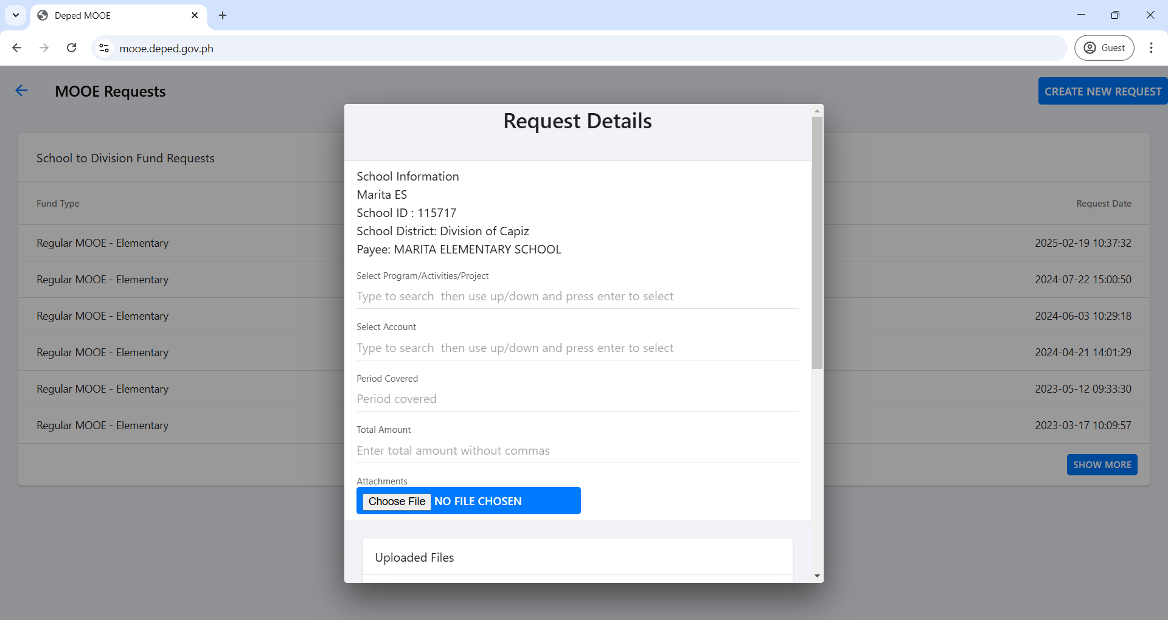
SCHOOL HEAD ACCOUNT
(FUND REQUEST)
Regular MOOE - Elementary
Land Bank of the Philippines Roxas Branch:001234-5678-90
2025-01-01 – 2025-03-31
100000

Slide 34
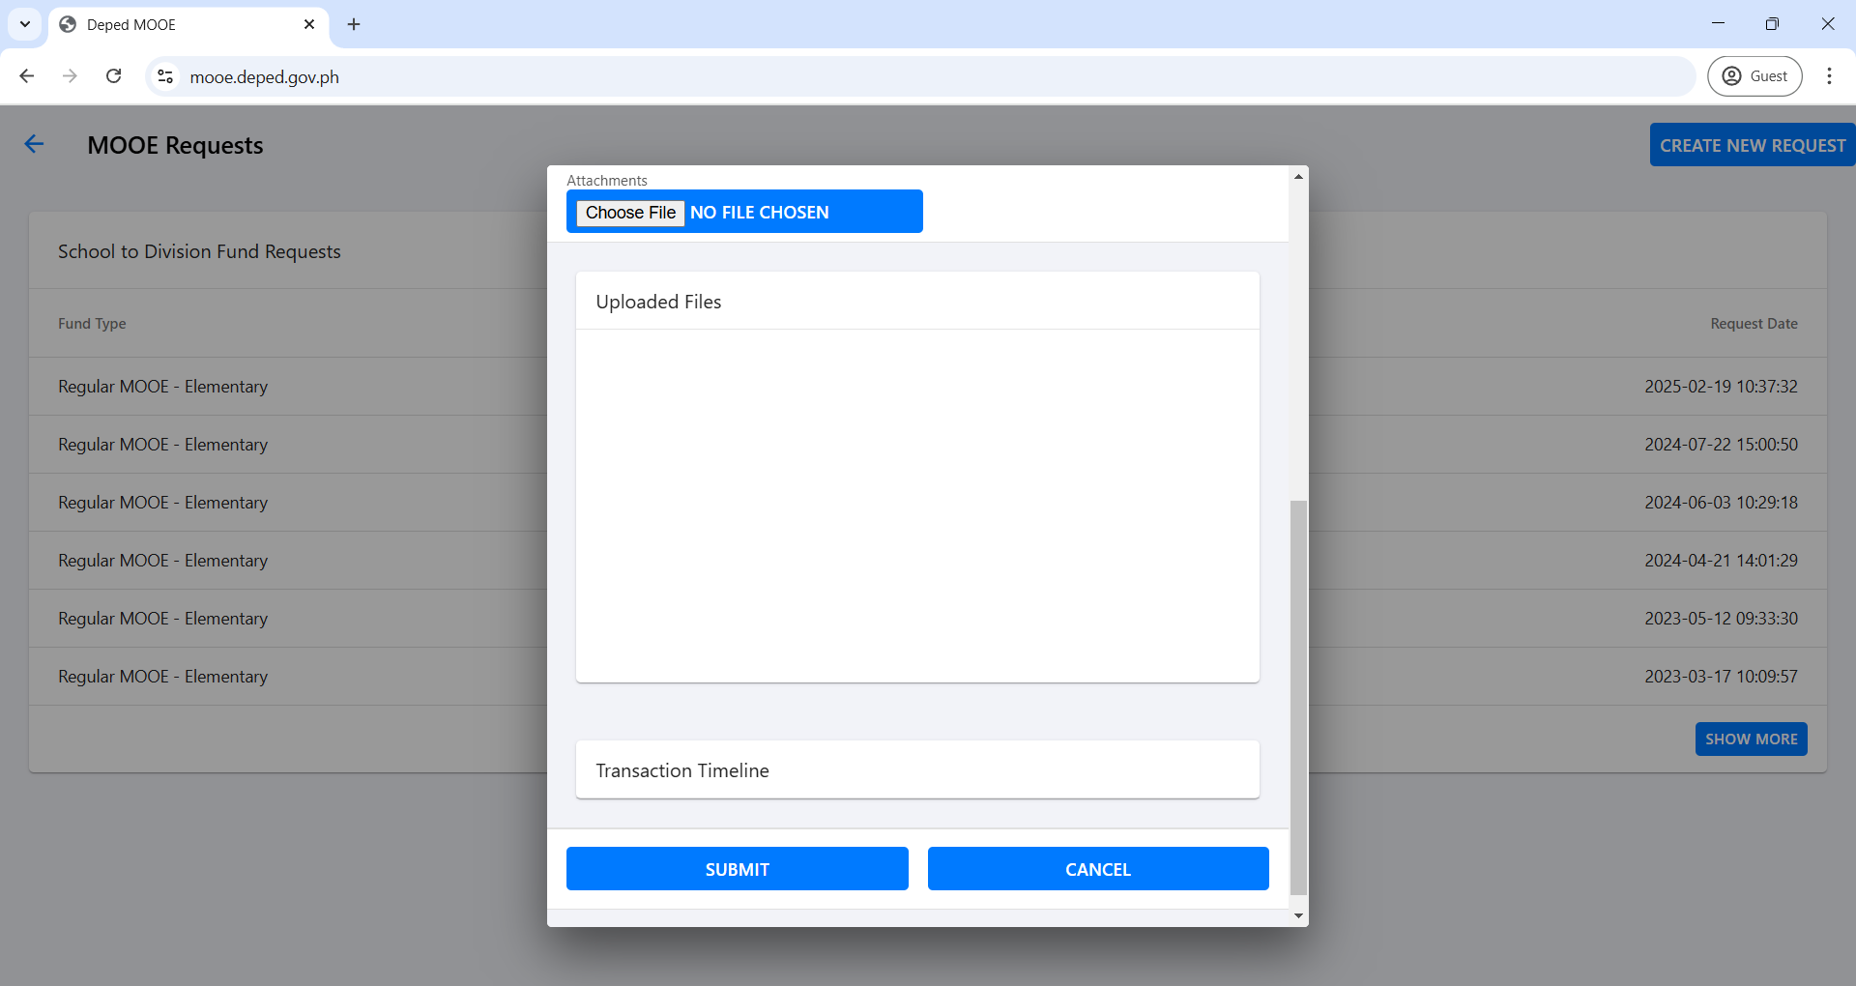
SCHOOL HEAD ACCOUNT
(FUND REQUEST)

Slide 35
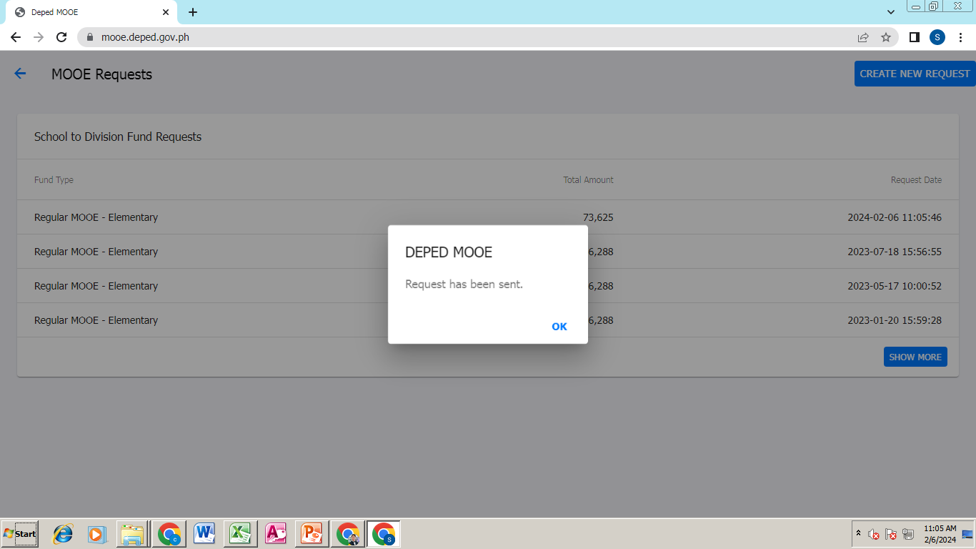
SCHOOL HEAD ACCOUNT
(FUND REQUEST)

Slide 36

REVIEW AND APPROVAL OF
FUND TRANSFER
(SDO Accounts)

Slide 37

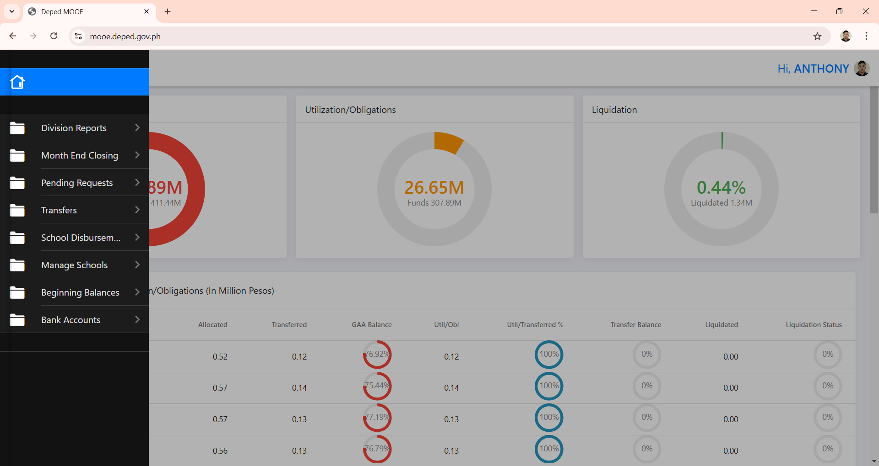
SDO ACCOUNT
(FUND REQUEST REVIEW)

Slide 38
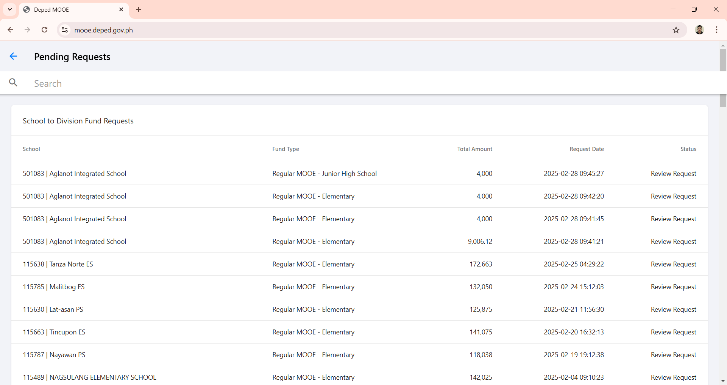
SDO ACCOUNT
(FUND REQUEST REVIEW)

Slide 39
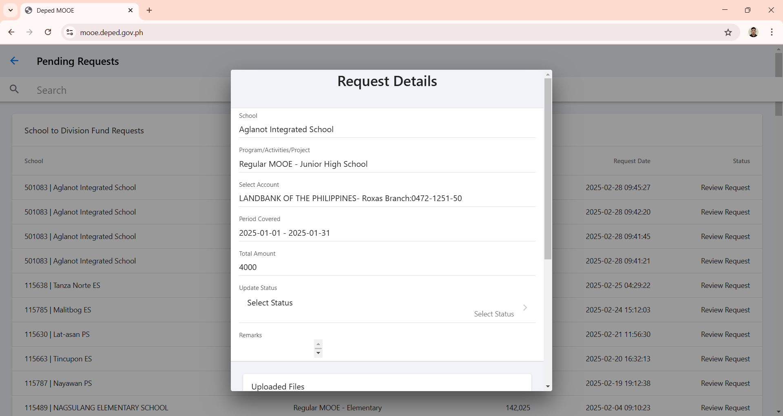
SDO ACCOUNT
(FUND REQUEST REVIEW)

Slide 40
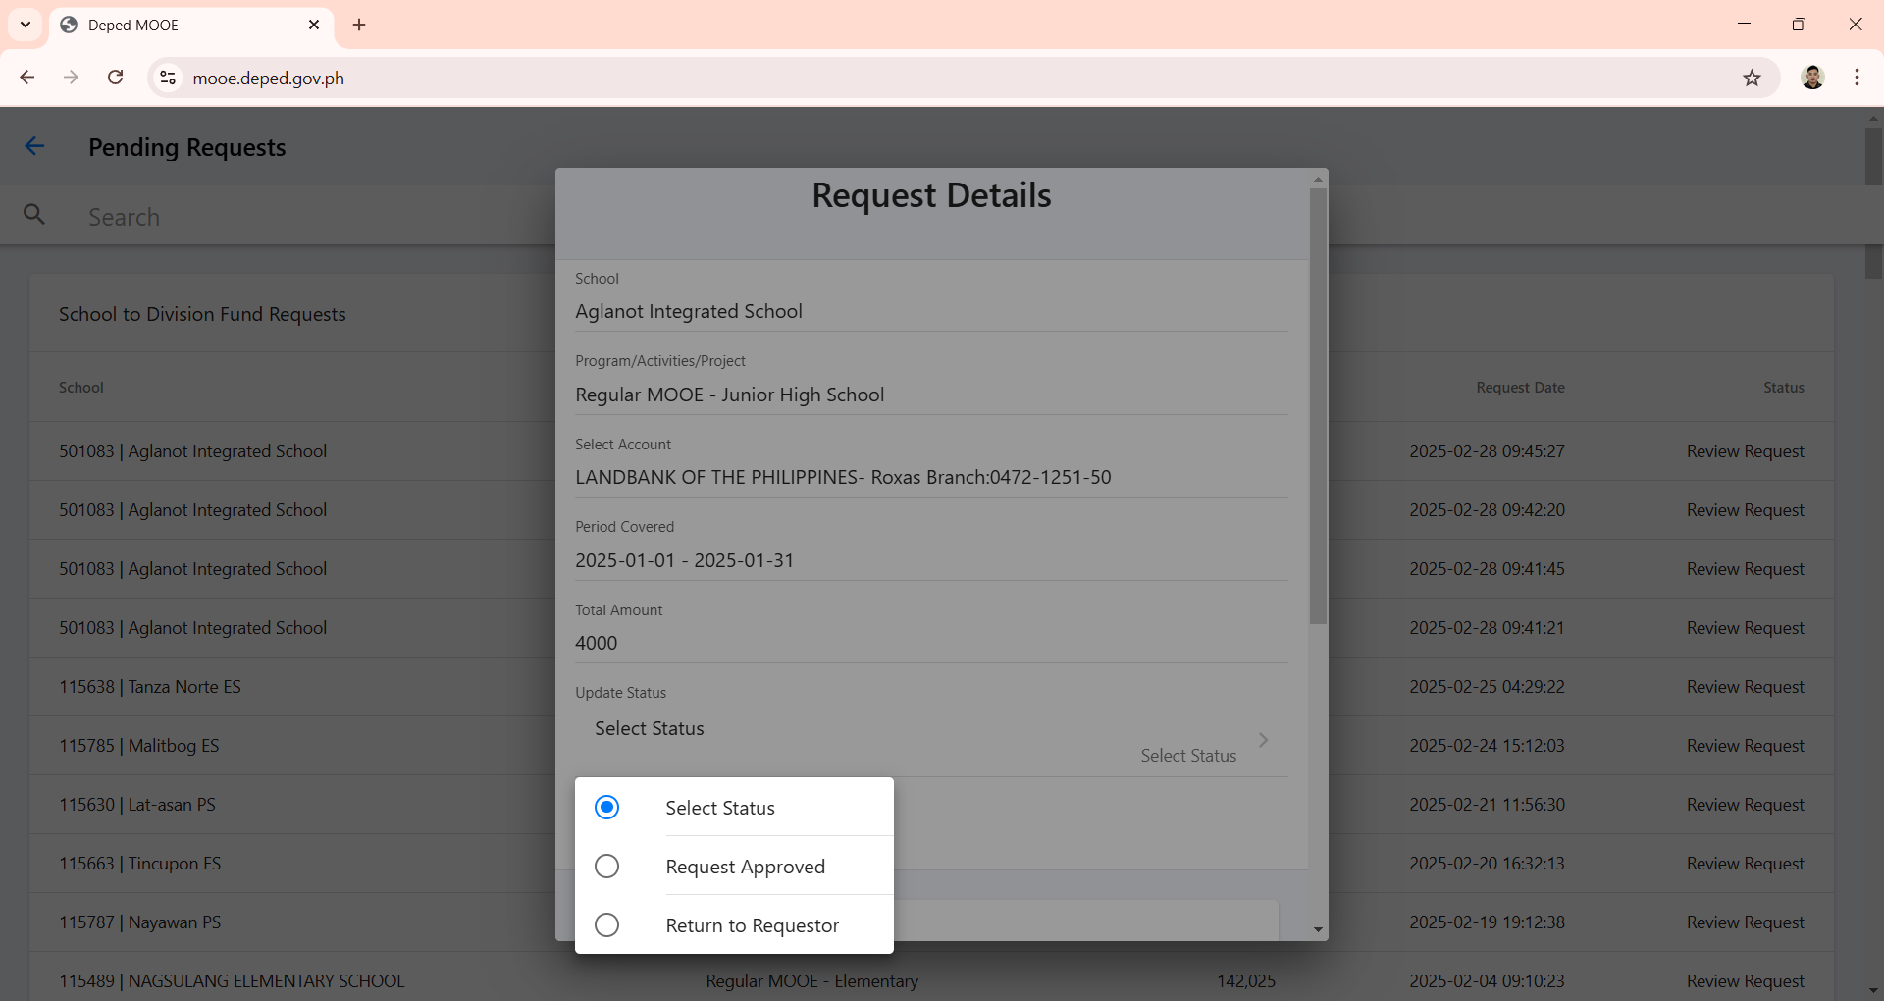
SDO ACCOUNT
(FUND REQUEST REVIEW)

Slide 41
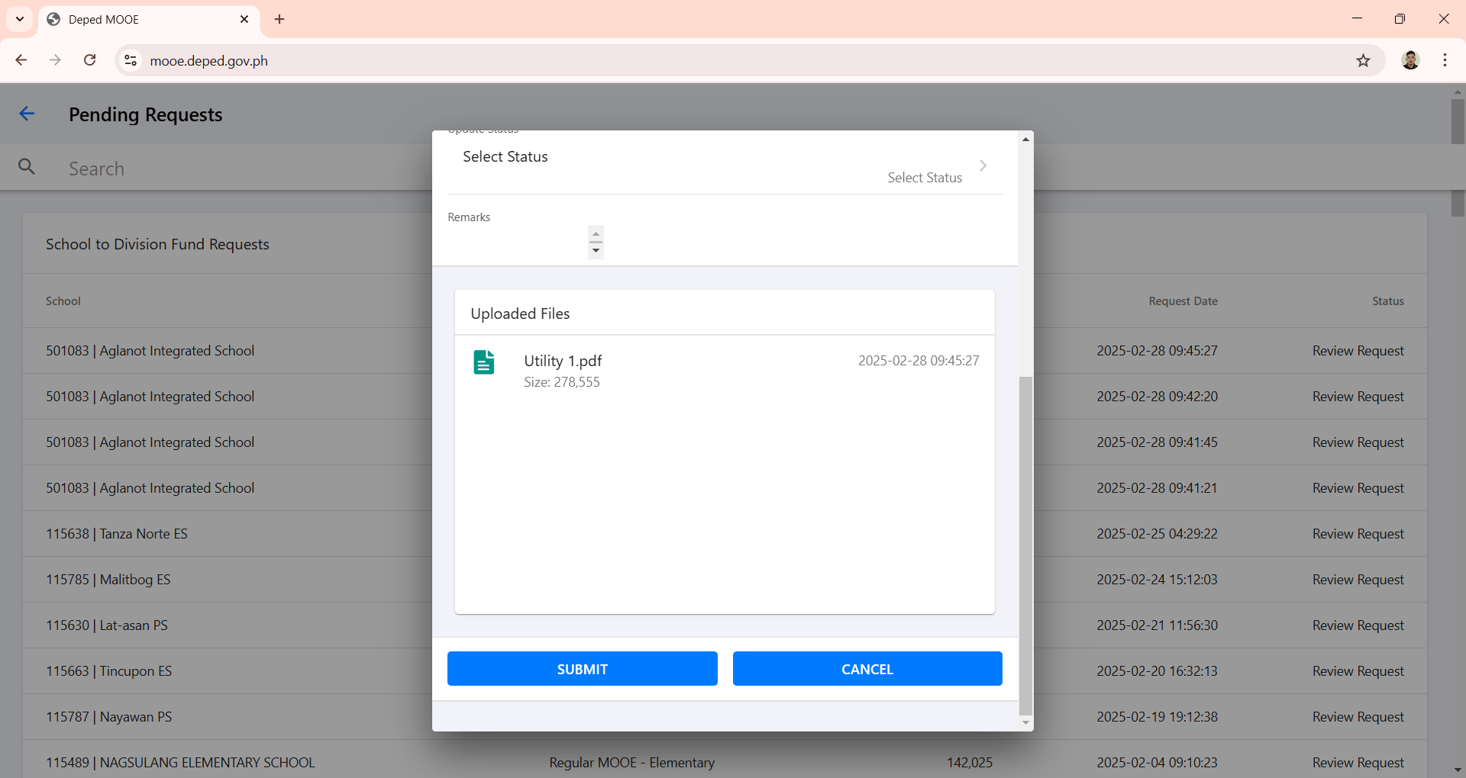
SDO ACCOUNT
(FUND REQUEST REVIEW)

Slide 42
After the School Head successfully submits the fund request, the approver (SDO Account) will review the correctness of the submission. If any errors are found, the request will be returned to the requestor for correction. If no errors are present, the approver (SDO Account) will approve the request and will proceed to creating of transfer.

Slide 43

CREATION OF FUND TRANSFER
(SDO Accounts)

Slide 44

SDO ACCOUNT
(CREATION OF TRANSFER)

Slide 45
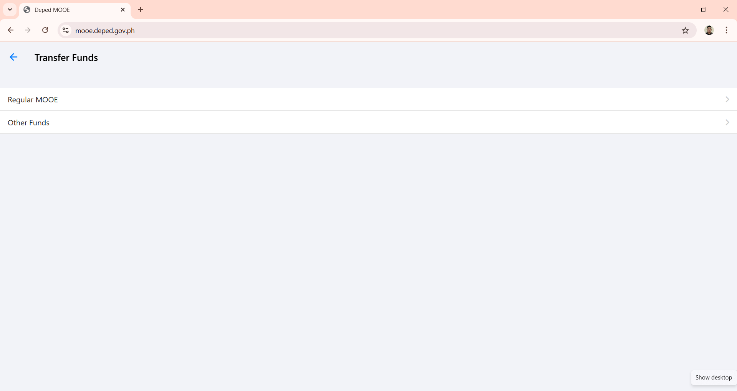
SDO ACCOUNT
(CREATION OF TRANSFER)

Slide 46
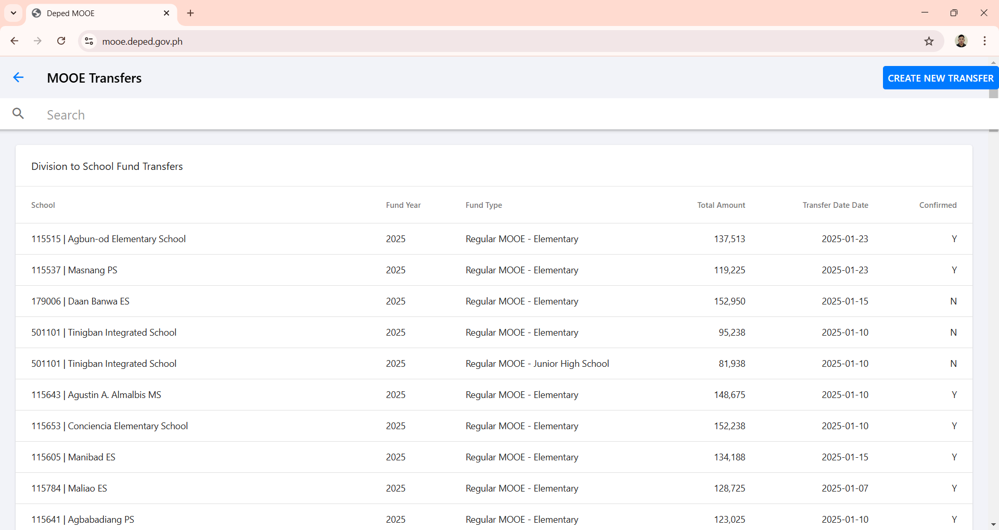
SDO ACCOUNT
(CREATION OF TRANSFER)

Slide 47
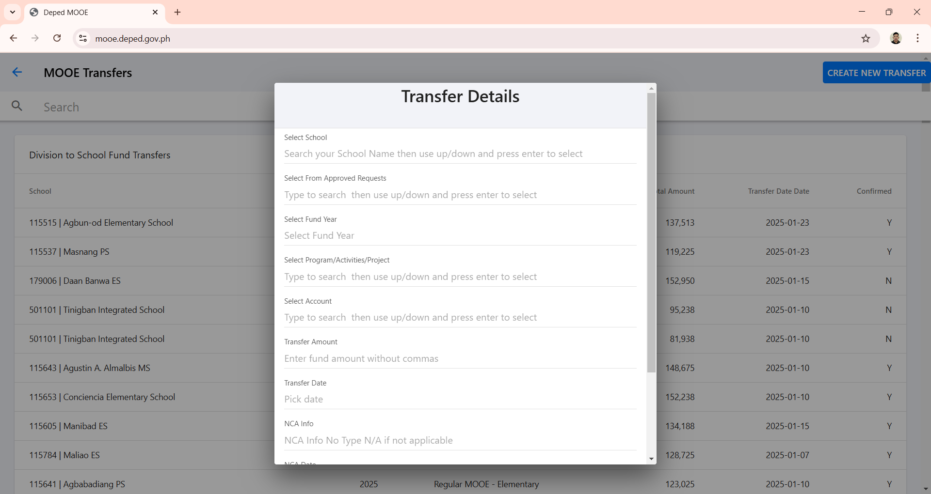
SDO ACCOUNT
(CREATION OF TRANSFER)
MARITA ELEMENTARY SCHOOL
2025-01-27 | Regular MOOE - Elementary
2025
Regular MOOE - Elementary
LAND BANK OF THE PHILIPPINES:1234-5678-90
100000
JANUARY 10, 2025
N/A

Slide 48
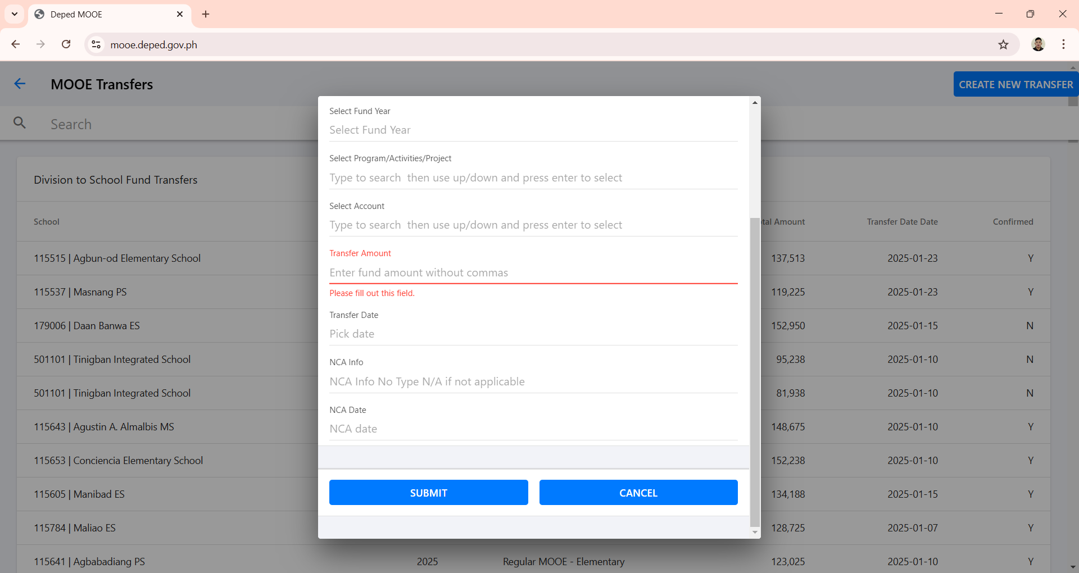
SDO ACCOUNT
(CREATION OF TRANSFER)

Slide 49
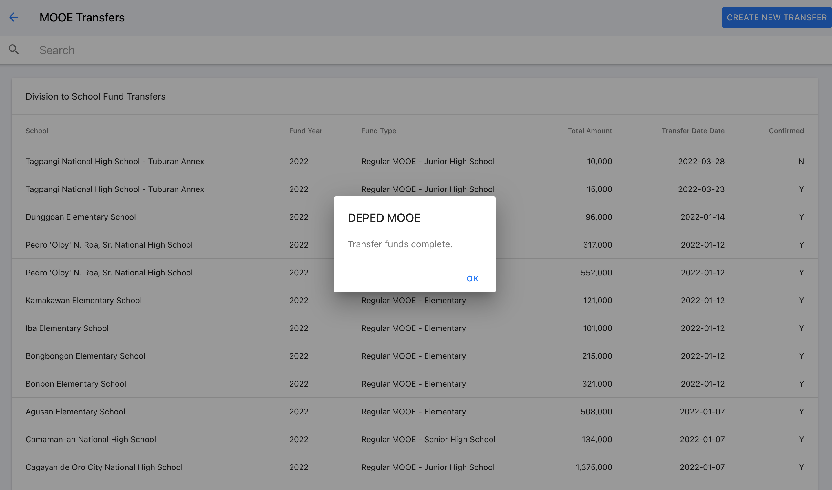
SDO ACCOUNT
(CREATION OF TRANSFER)

Slide 50

CONFIRMATION OF
FUND TRANSFER
(School Head Account)

Slide 51

CONFIRMATION OF FUND TRANSFER
(SCHOOL HEAD ACCOUNT)

Slide 52
CONFIRMATION OF FUND TRANSFER
(SCHOOL HEAD ACCOUNT)

Slide 53
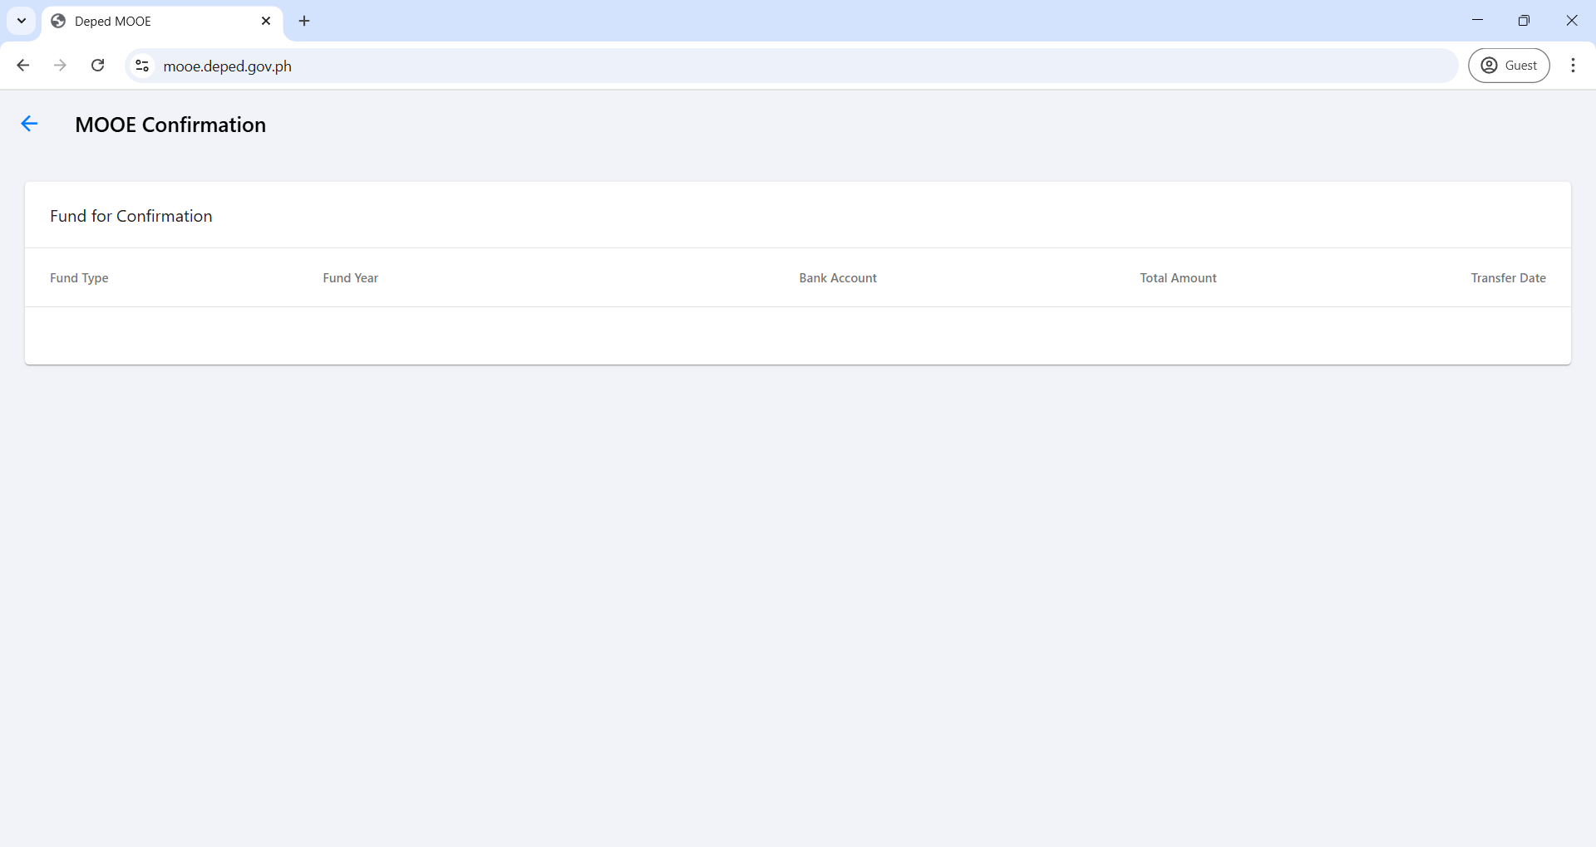
CONFIRMATION OF FUND TRANSFER
(SCHOOL HEAD ACCOUNT)
REGULAR MOOE - ELEMENTARY
2025
1234-5678-90
100,000
2025-01-10

Slide 54
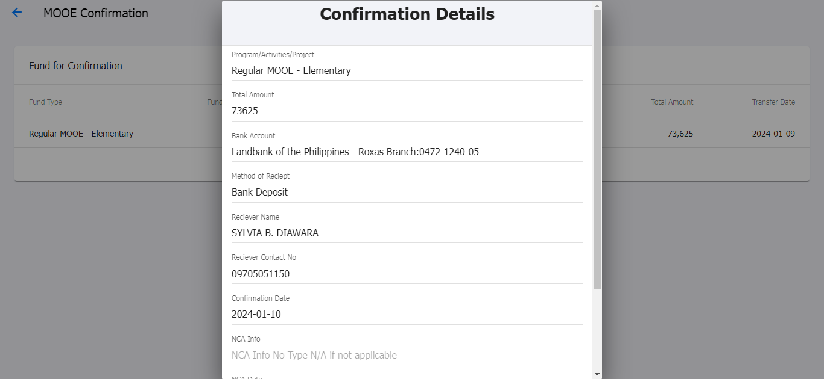
CONFIRMATION OF FUND TRANSFER
(SCHOOL HEAD ACCOUNT)
REGULAR MOOE - ELEMENTARY
100000
LAND BANK OF THE PHILIPPINES:1234-5678-900
BANK DEPOSIT
MAY F. DOLOR
09123456789
NOTE: The confirmation date refers to the day the funds were deposited. It is advisable to verify this information through Snapshot or WeAccess.
JANUARY 24, 2025
N/A

Slide 55
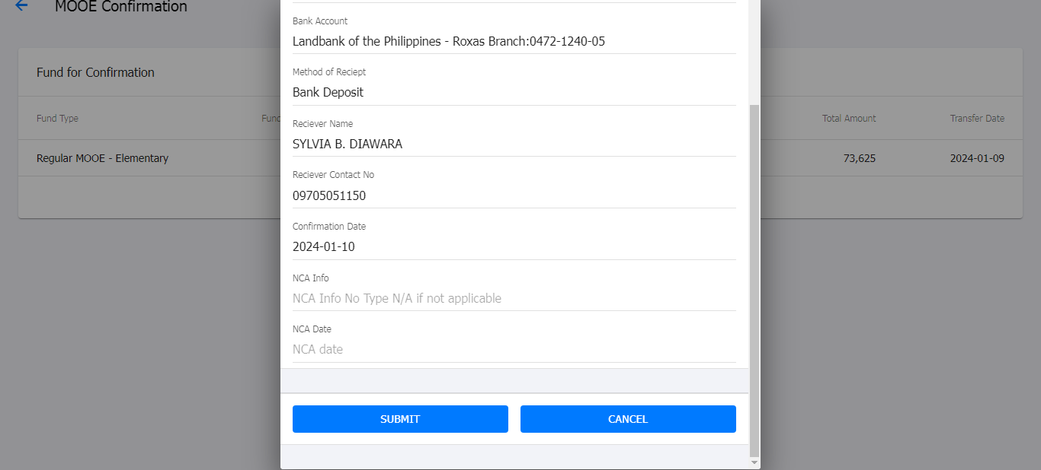
CONFIRMATION OF FUND TRANSFER
(SCHOOL HEAD ACCOUNT)

Slide 56
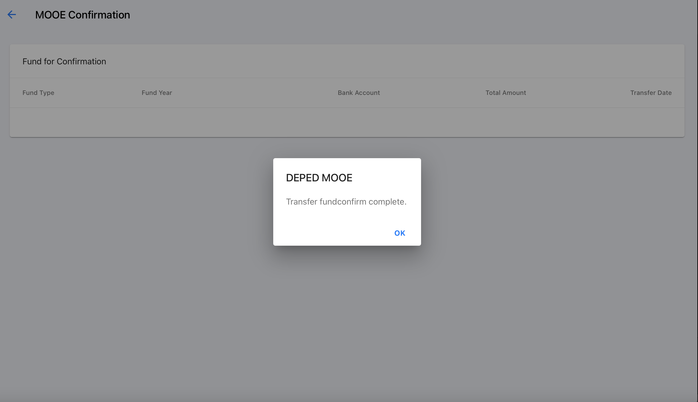
CONFIRMATION OF FUND TRANSFER
(SCHOOL HEAD ACCOUNT)

Slide 57

DISBURSEMENT
(School Account)

Slide 58

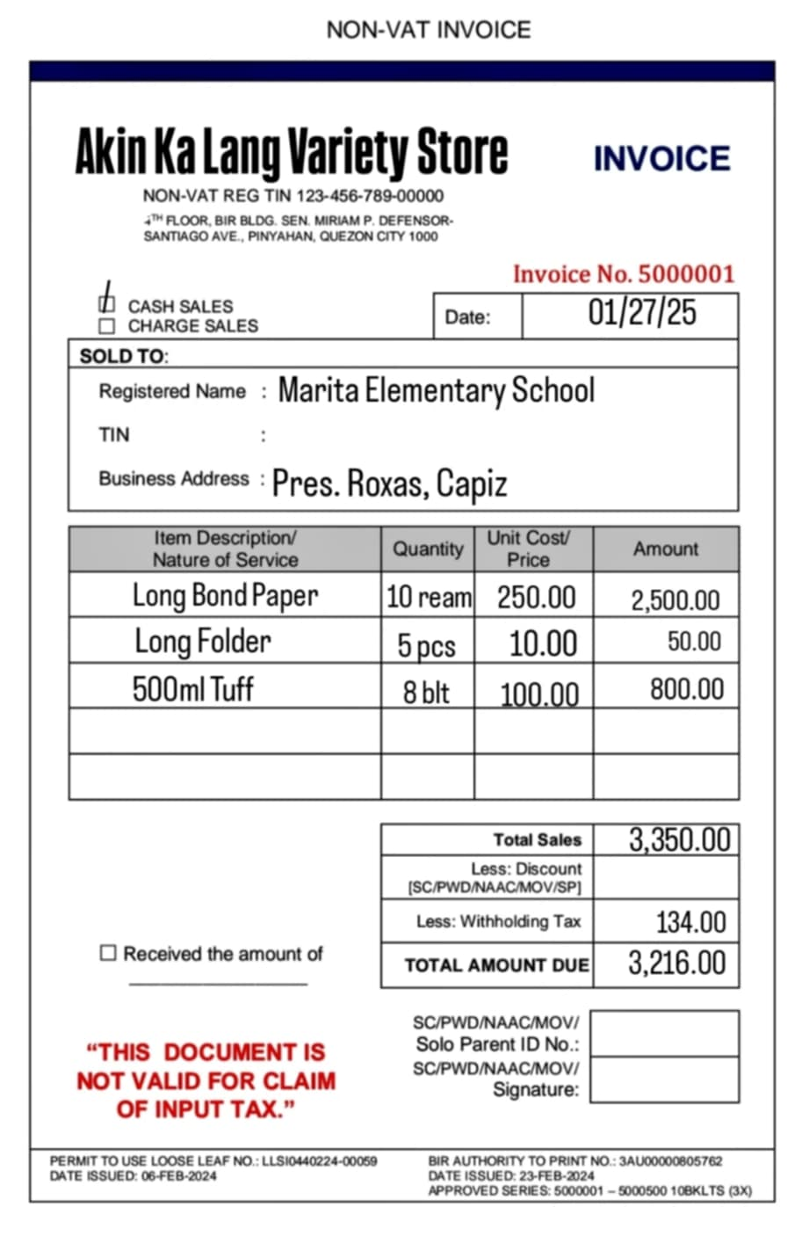
SAMPLE RECEIPT
(OFFICE SUPPLIES AND CLEANING SUPPLIES)

Slide 59
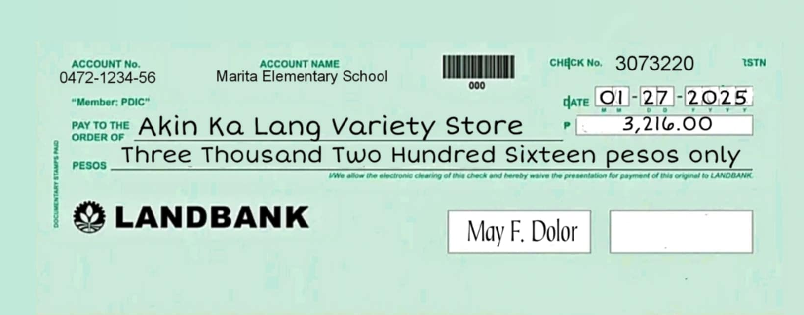
SAMPLE CHEQUE
(OFFICE SUPPLIES AND CLEANING SUPPLIES)

Slide 60
CREATION OF DISBURSEMENT (DV)
(NON-VAT GOODS)

Slide 61
CREATION OF DISBURSEMENT (DV)
(NON-VAT GOODS)

Slide 62
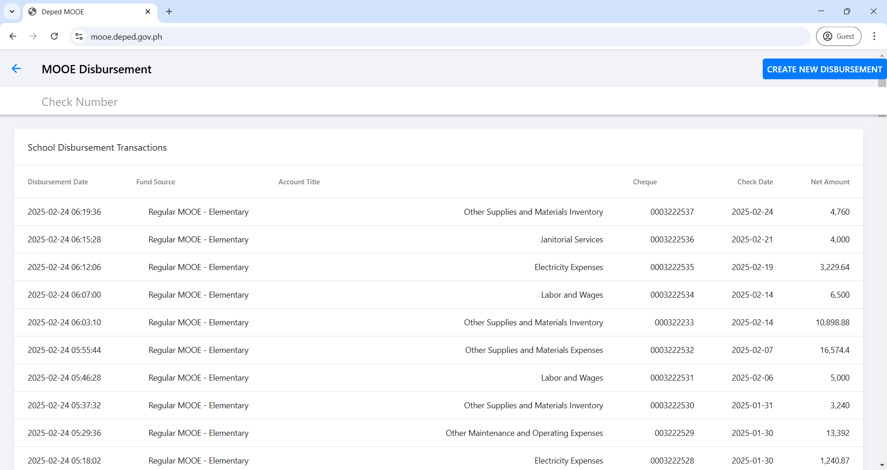
CREATION OF DISBURSEMENT (DV)
(NON-VAT GOODS)

Slide 63
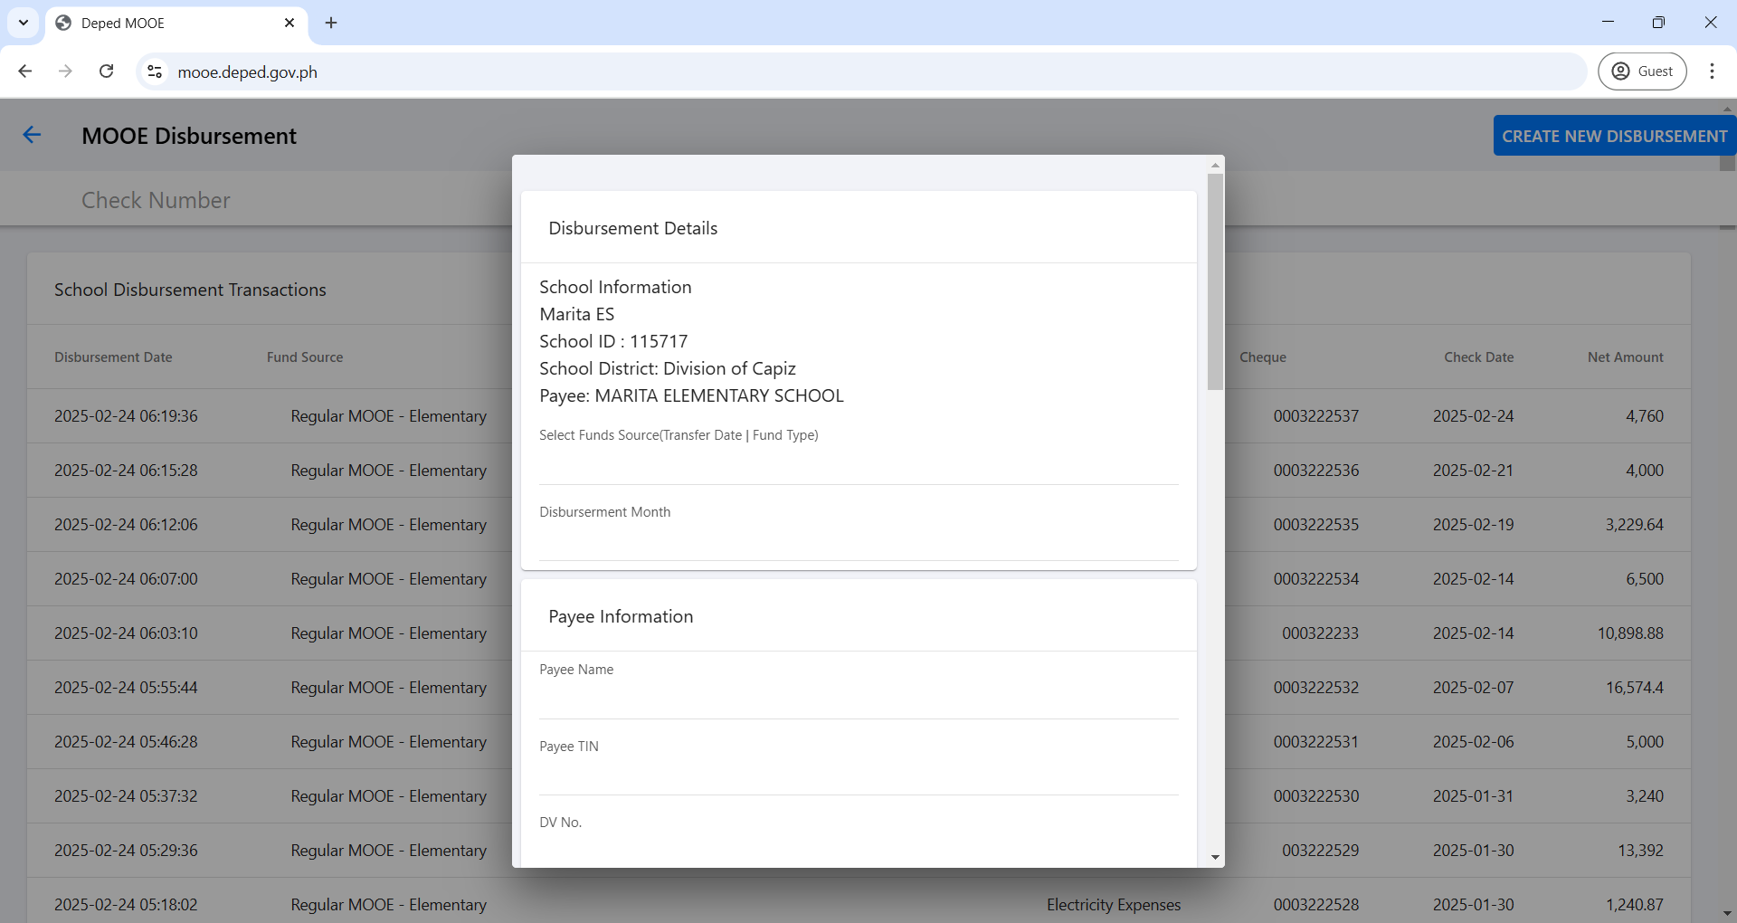
CREATION OF DISBURSEMENT (DV)
(NON-VAT GOODS)
2025-01-10 | Regular MOOE - Elementary | Land Bank of the Philippines Roxas Br
JANUARY
AKIN KA LANG VARIETY STORE
12345678900000
2025-01-001

Slide 64
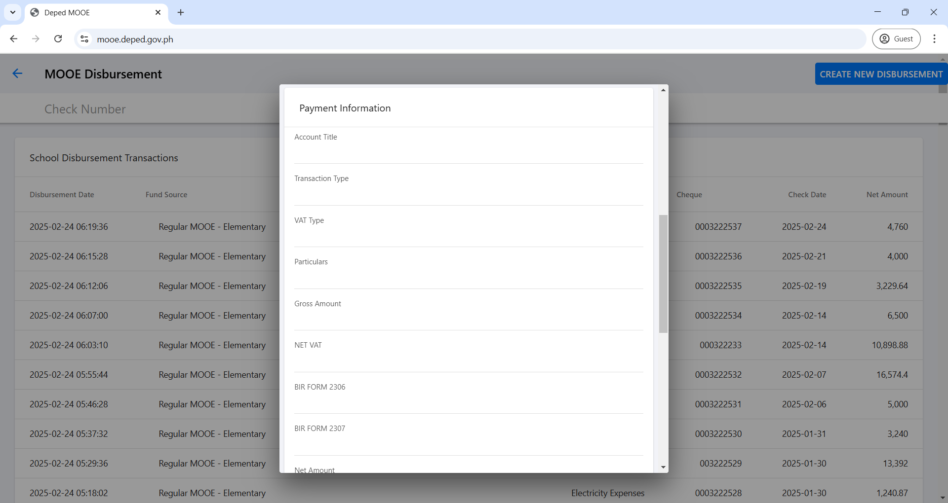
CREATION OF DISBURSEMENT (DV)
(NON-VAT GOODS)
5020301000 - Office Supplies Expenses
OTHER TRANSACTION
NON-VAT
PAYMENT FOR THE PURCHASE OF OFFICE SUPPLIES
3350
3350
100.50
33.50

Slide 65
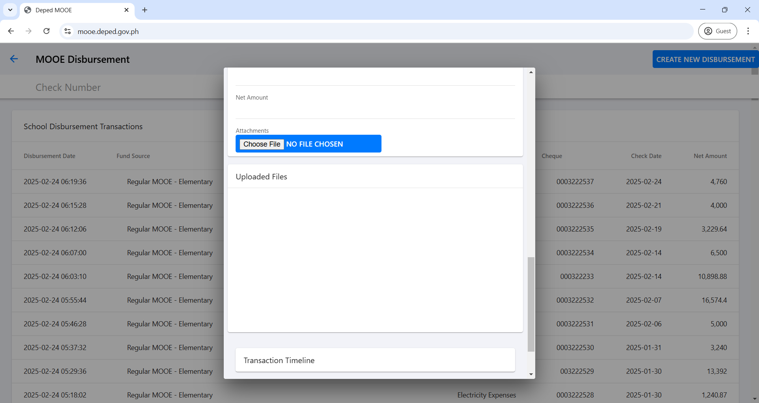
CREATION OF DISBURSEMENT (DV)
(NON-VAT GOODS)
3216

Slide 66
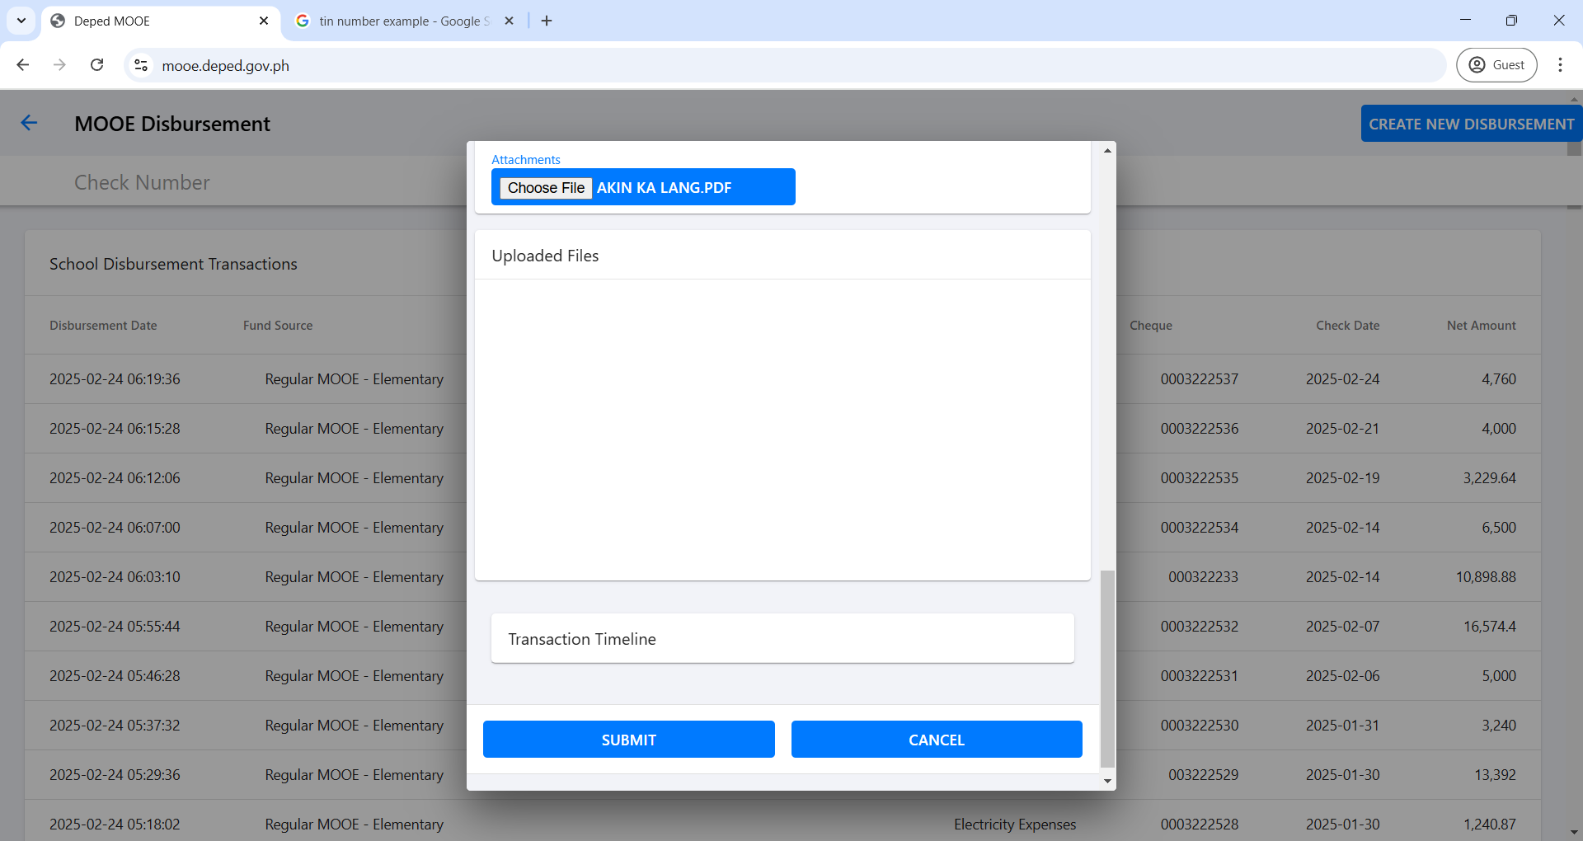
CREATION OF DISBURSEMENT (DV)
(NON-VAT GOODS)
ATTACH HERE THE SCANNED COPY OF CHECK AND RECEIPT

Slide 67
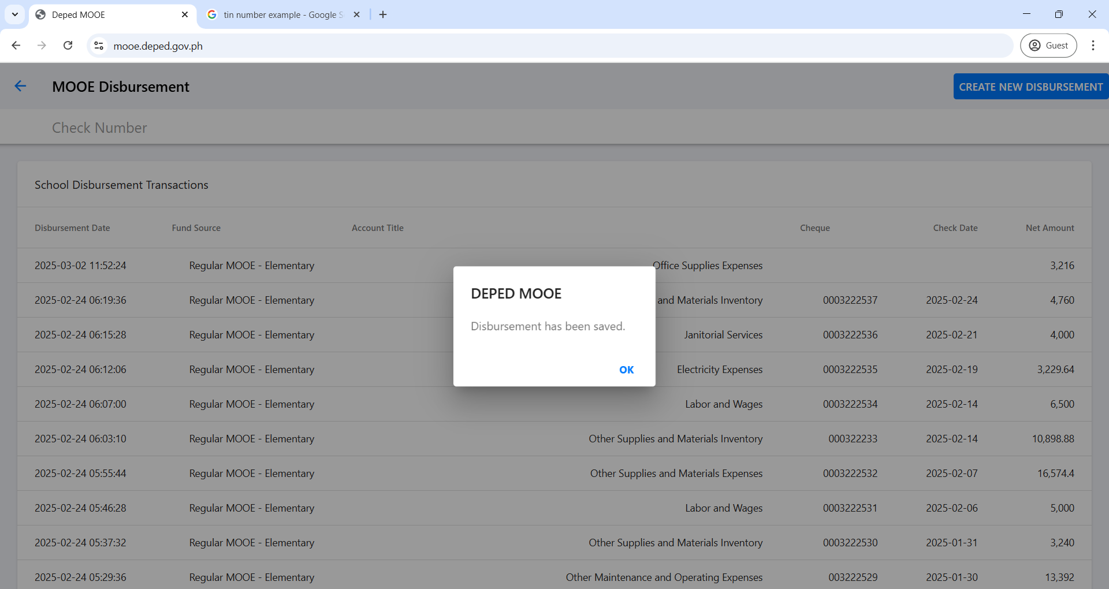
CREATION OF DISBURSEMENT (DV)
(NON-VAT GOODS)

Slide 68
CREATION OF DISBURSEMENT (DV)
(NON-VAT GOODS)

Slide 69

CREATION OF DISBURSEMENT (DV)
(NON-VAT GOODS)

Slide 70
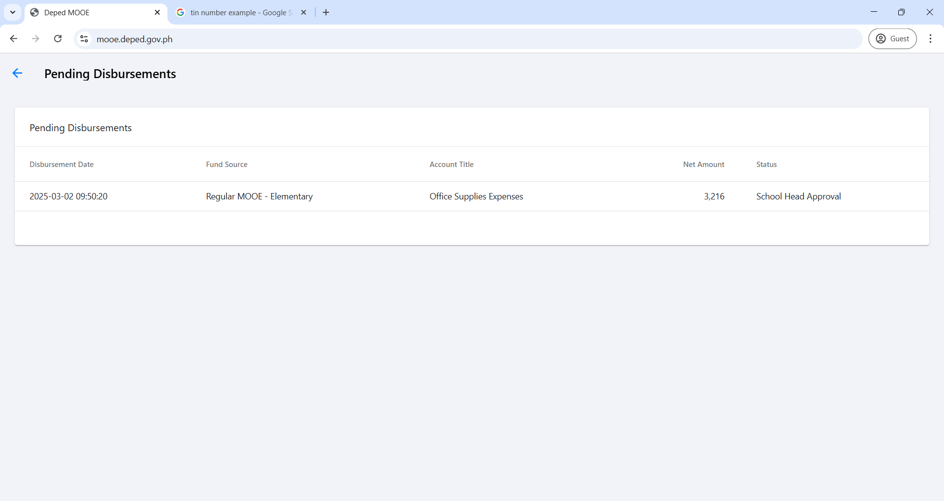
CREATION OF DISBURSEMENT (DV)
(NON-VAT GOODS)

Slide 71
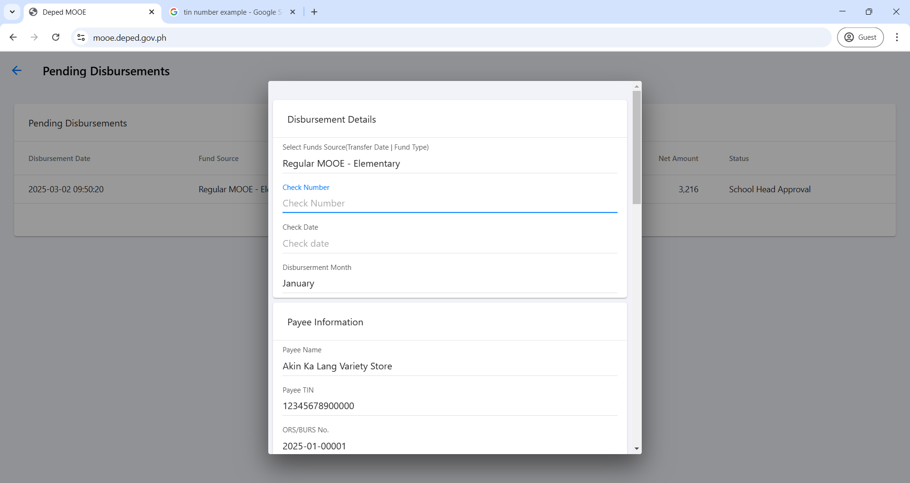
CREATION OF DISBURSEMENT (DV)
(NON-VAT GOODS)

Slide 72
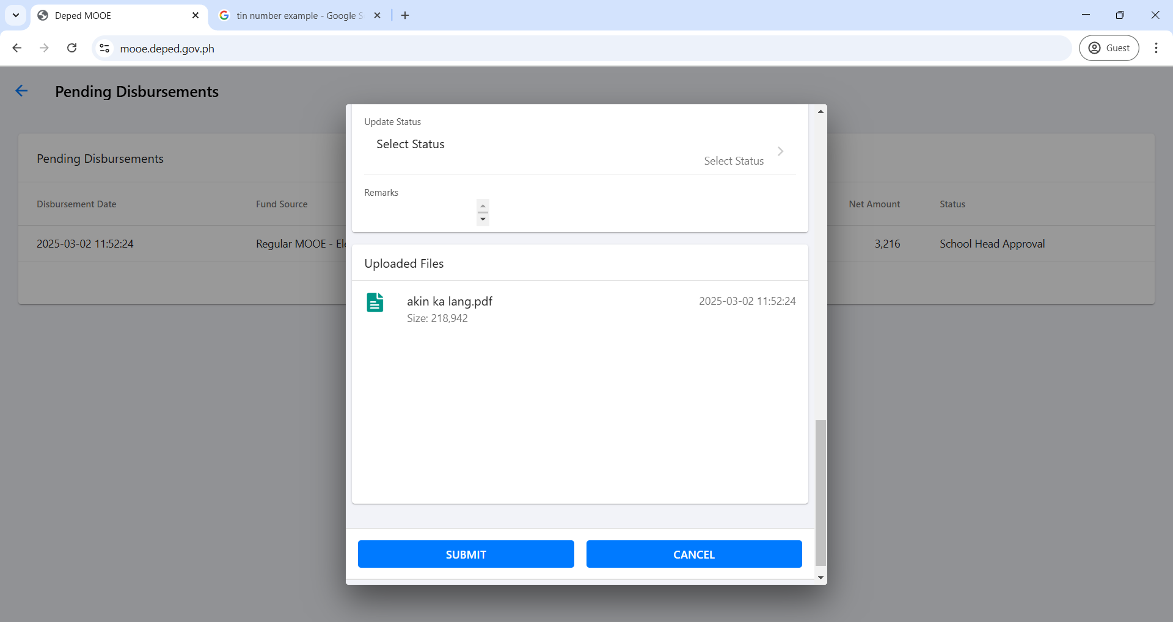
CREATION OF DISBURSEMENT (DV)
(NON-VAT GOODS)

Slide 73
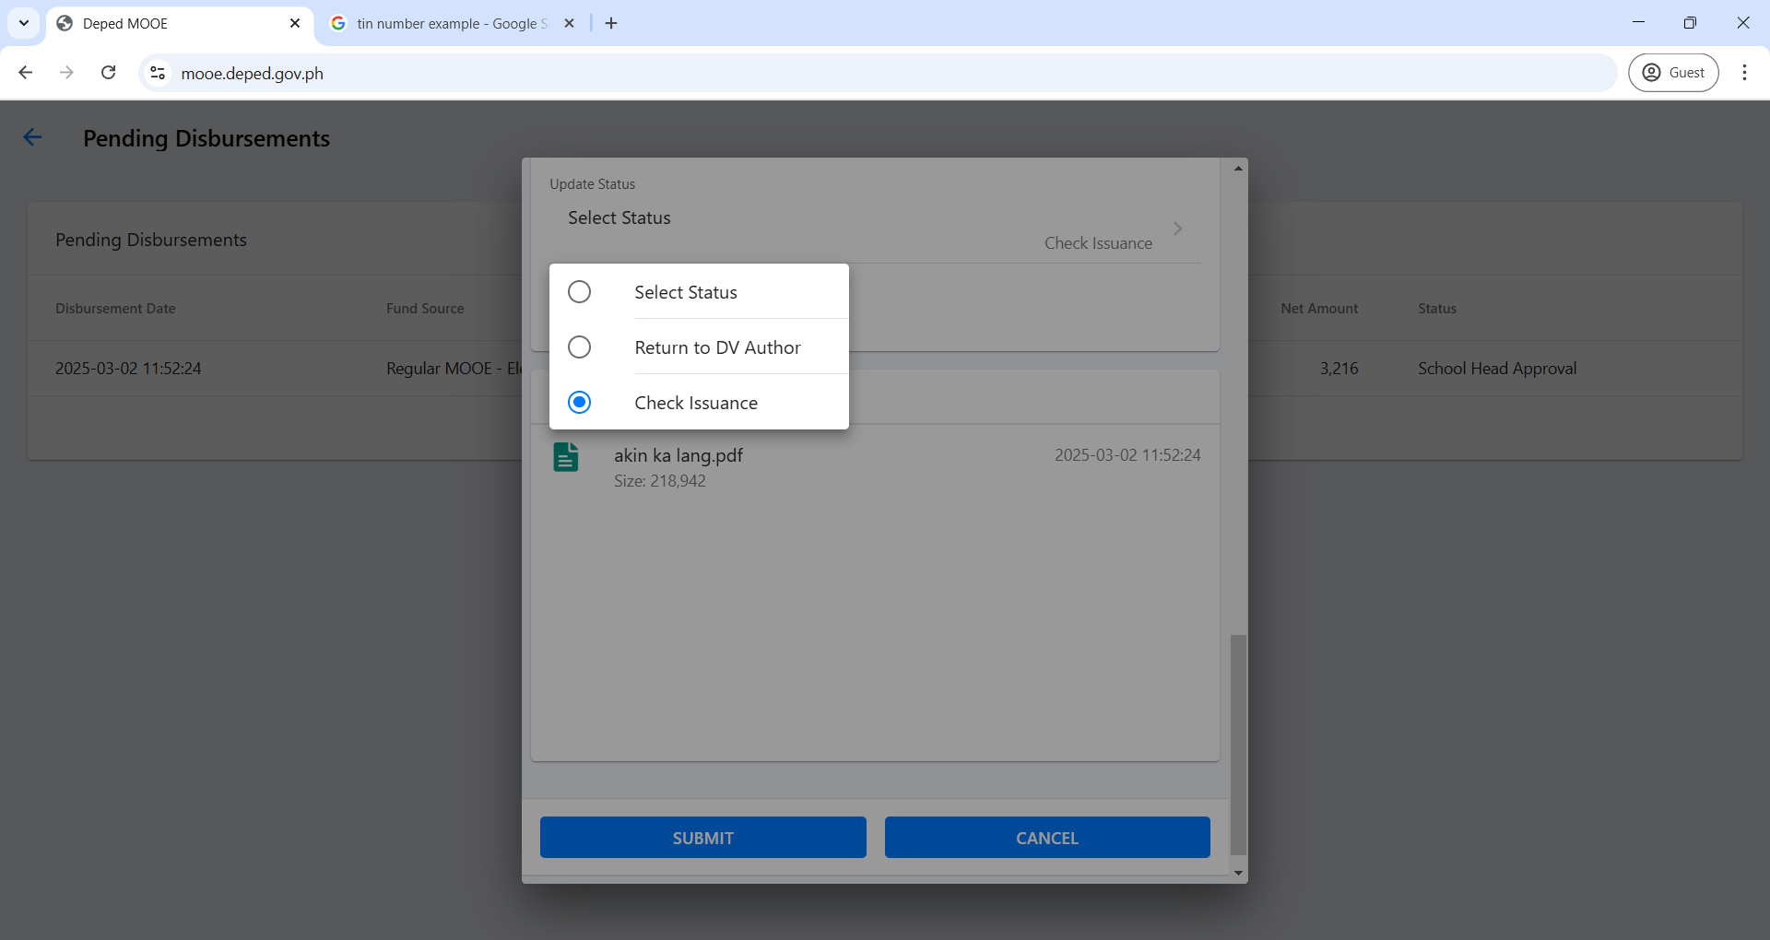
CREATION OF DISBURSEMENT (DV)
(NON-VAT GOODS)

Slide 74

CREATION OF DISBURSEMENT (DV)
(NON-VAT GOODS)

Slide 75
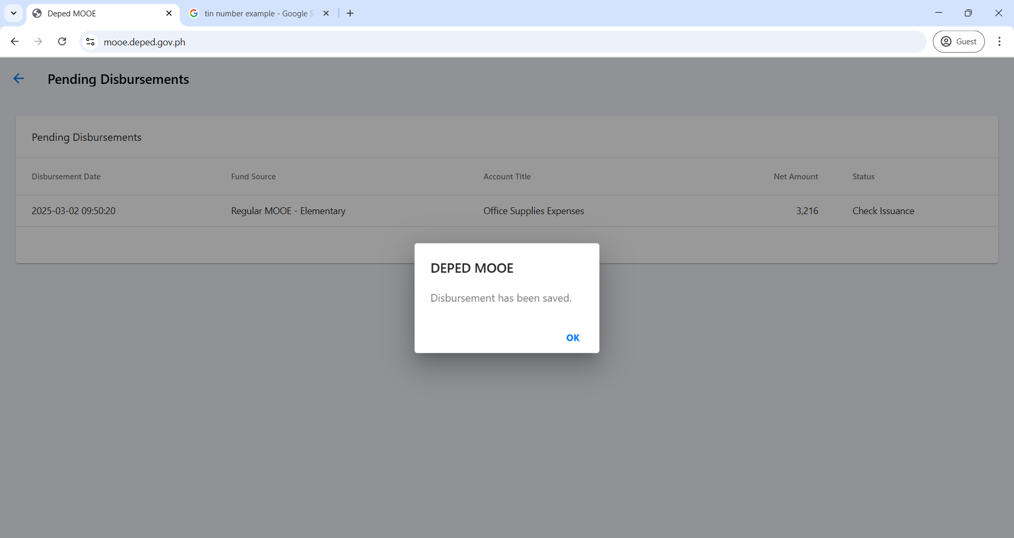
CREATION OF DISBURSEMENT (DV)
(NON-VAT GOODS)

Slide 76
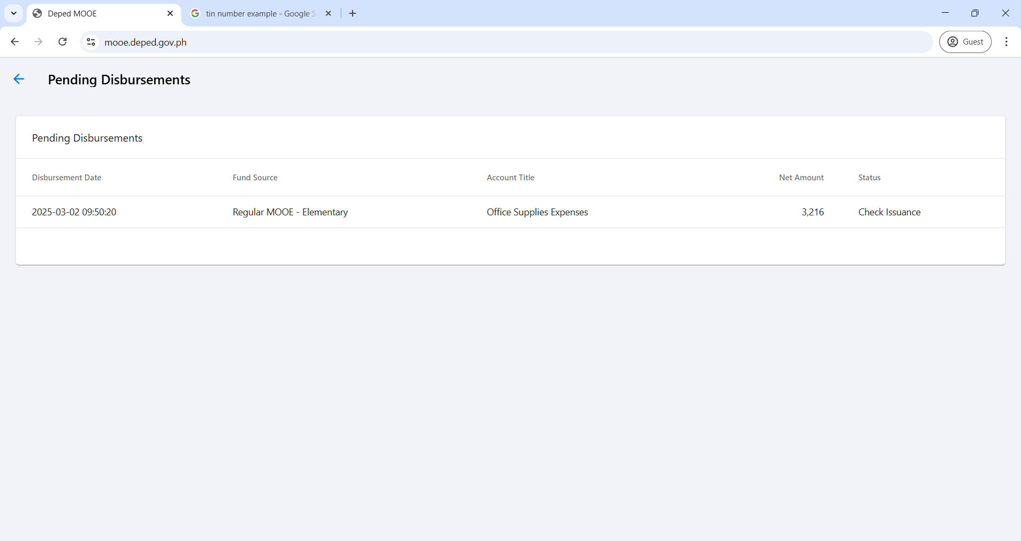
CREATION OF DISBURSEMENT (DV)
(NON-VAT GOODS)

Slide 77
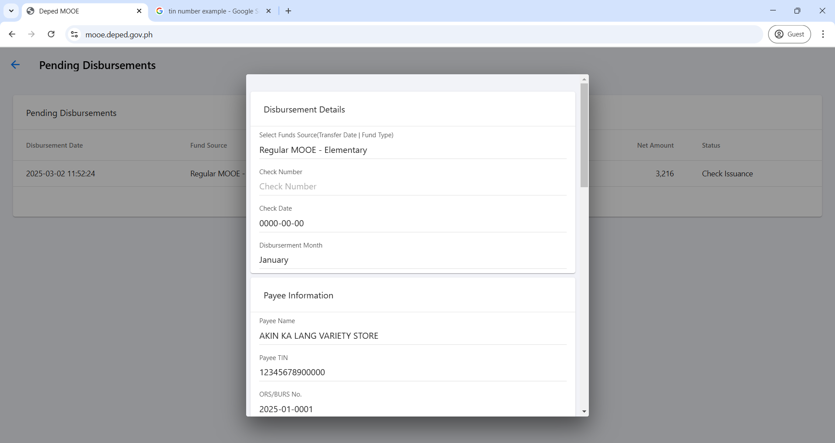
CREATION OF DISBURSEMENT (DV)
(NON-VAT GOODS)
3073220
2025-01-27
January

Slide 78

CREATION OF DISBURSEMENT (DV)
(NON-VAT GOODS)

Slide 79

CREATION OF DISBURSEMENT (DV)
(NON-VAT GOODS)

Slide 80

CREATION OF DISBURSEMENT (DV)
(NON-VAT GOODS)

Slide 81
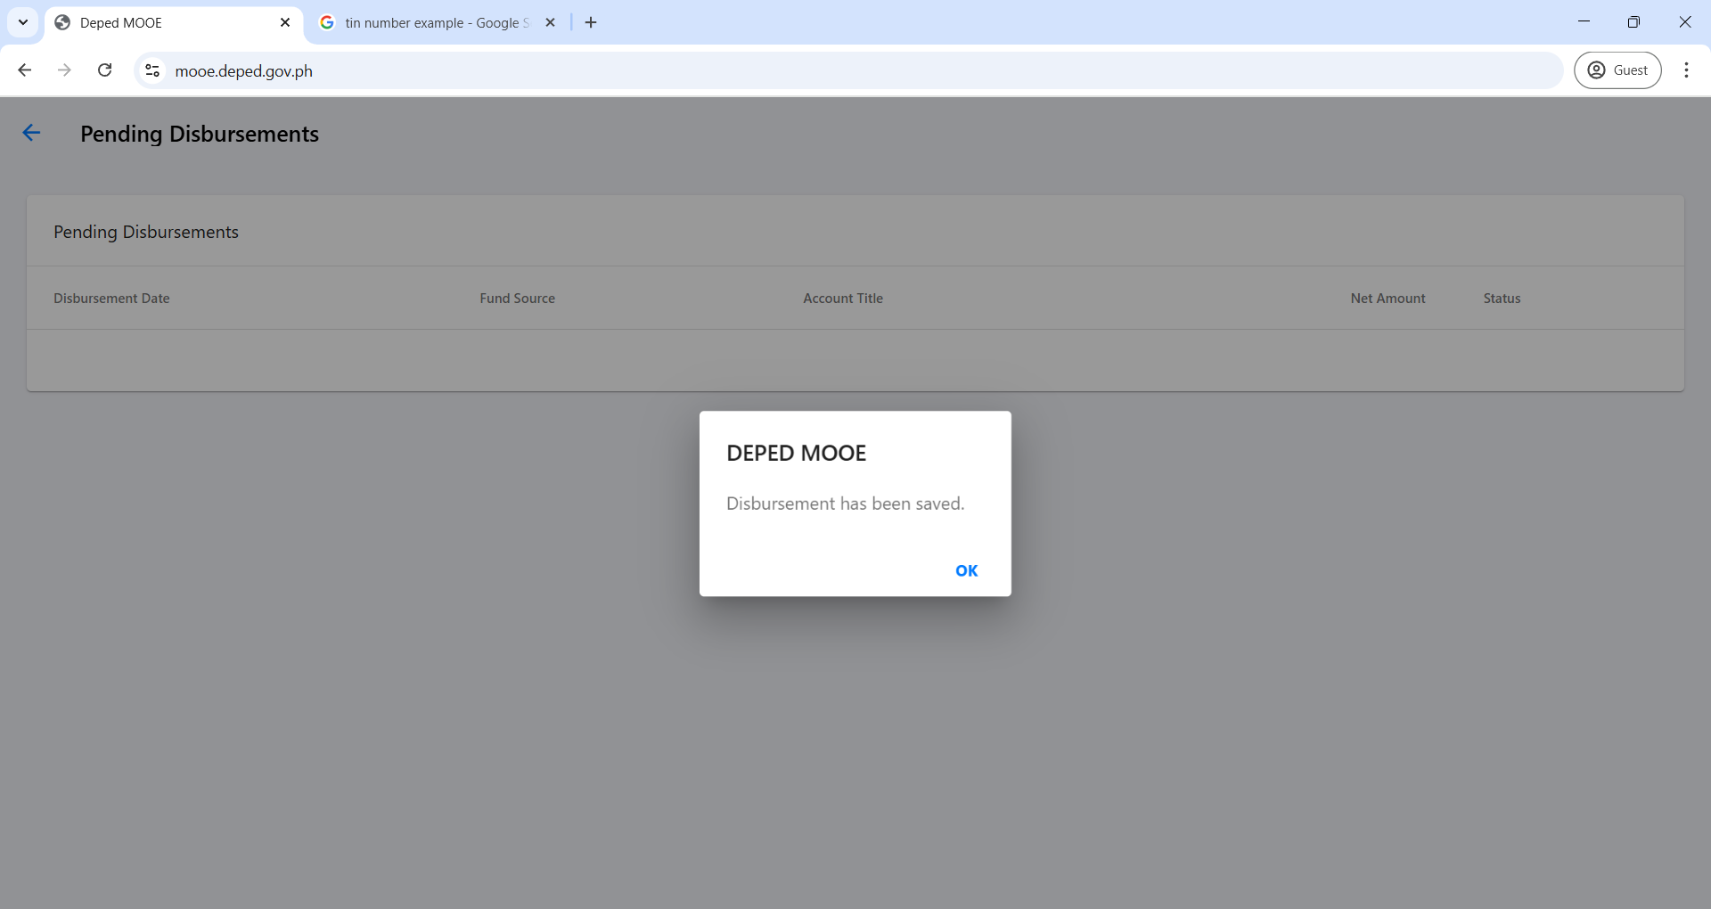
CREATION OF DISBURSEMENT (DV)
(NON-VAT GOODS)

Slide 82
CREATION OF DISBURSEMENT (DV)
(NON-VAT GOODS)

Slide 83
CREATION OF DISBURSEMENT (DV)
(NON-VAT GOODS)

Slide 84
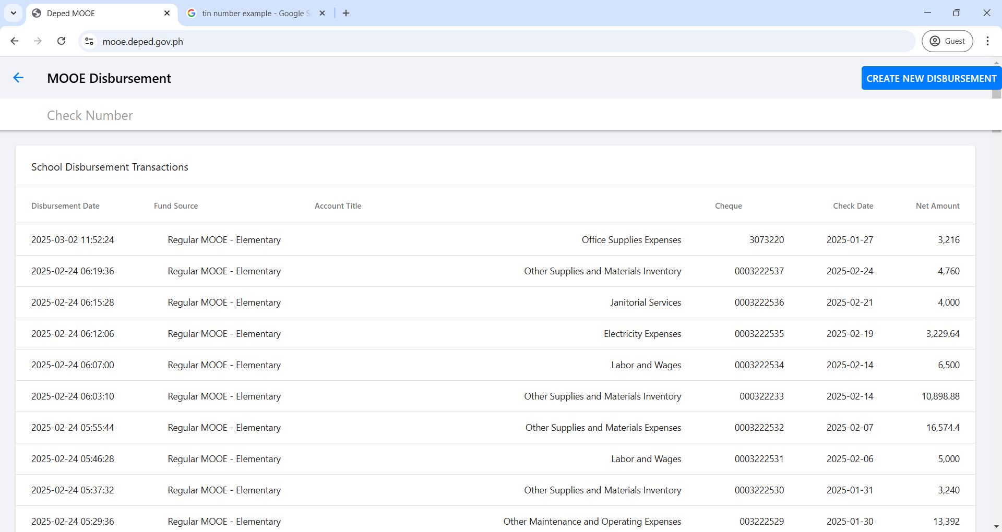
CREATION OF DISBURSEMENT (DV)
(NON-VAT GOODS)

Slide 85

CREATION OF DISBURSEMENT (DV)
(NON-VAT GOODS)

Slide 86

CREATION OF DISBURSEMENT (DV)
(NON-VAT GOODS)

Slide 87


CREATION OF DISBURSEMENT (DV)
(NON-VAT GOODS)
MARIE C. GAVA
CHANGE TO SCHOOL TREASURER TO THOSE SCHOOLS THAT HAS NO ADAS III

Slide 88
CREATION OF DISBURSEMENT (DV)
(NON-VAT GOODS)

Slide 89
CREATION OF DISBURSEMENT (DV)
(VAT GOODS)

Slide 90
CREATION OF DISBURSEMENT (DV)
(VAT GOODS)

Slide 91
CREATION OF DISBURSEMENT (DV)
(VAT GOODS)

Slide 92

SAMPLE RECEIPT
(R&M BUILDINGS AND OTHER STRUCTURES)

Slide 93
CREATION OF DISBURSEMENT (DV)
(VAT GOODS)
2025-01-10 | Regular MOOE - Elementary | Land Bank of the Philippines Roxas Br
FEBRUARY
SOBRANG LATINA BUILDERS DEPOT
12345678900000
2025-02-002

Slide 94
CREATION OF DISBURSEMENT (DV)
(VAT GOODS)
5021304002 - Repair & Maint. - School Buildings
GOODS
VAT
PAYMENT FOR THE PURCHASE OF MATERIALS FOR THE REPAIR OF DOOR OF GRADE 1 BUILDING
5750
5133.93
256.70
51.34

Slide 95
CREATION OF DISBURSEMENT (DV)
(VAT GOODS)
5441.96

Slide 96

CREATION OF DISBURSEMENT (DV)
(VAT GOODS)

Slide 97

CREATION OF DISBURSEMENT (DV)
(VAT GOODS)

Slide 98
CREATION OF DISBURSEMENT (DV)
(NON-VAT GOODS)

Slide 99
CREATION OF DISBURSEMENT (DV)
(NON-VAT GOODS)

