Slide 1
REIMBURSEMENT

Slide 2
What is Reimbursement?
Reimbursement is the act of compensating someone for an out-of-pocket expenses by giving them an amount of money to what was spent in accordance with the guidelines.

Slide 3

Reimbursement is exempted in computation of TAX withheld.

Slide 4

Reimbursement
Reimbursement includes:
Petty Expenses Only
Emergency Expenses Only
Human Consideration

Slide 5
How to Liquidate Reimbursement?
Follow the checklist for every transaction.
Attach all necessary attachments such as OR/Sales Invoice/Service Invoice, RIS, PR, IAR, ICS, payroll, etc.
Prepare a Reimbursement Summary.
Continuation next slide

Slide 6
Kita-Kita Elementary School
District of Indi Madula
Reimbursement Summary Report
for January 2025
Date | Payee | Details | Account Name | Account Code | Amount
Jan. 10, 2025 | ABC Printing | Reproduction of forms | Printing & Publication | 5029902000 | 150.00
Jan. 15, 2025 | CAPELCO | Payment of Electricity for the month of January 2025 | Electricity Expense | 5020402000 | 687.54
Jan. 20, 2025 | Mang Inasar Hardware | Purchased 2 bulbs | Other Supplies and Mat. Expense | 5020399000 | 195.00
Jan. 20, 2025 | Marites Dimagiba | Daily Wage- Laundry of Curtains | Other MOOE | 5029999099 | 300.00
Jan. 30, 2025 | Juan Dela Cruz | Payment for school security for January 2025 | Security Services Expenses | 5021203000 | 3,000.00
Jan. 30, 2025 | Tanggol Montenegro | Travel Expenses-attending seminar | Travel Expenses | 5020101000 | 250.00
 |  |  |  |  | 4, 582.24
Notes:
.

Slide 7
How to Liquidate Reimbursement?
Once a month only - One Disbursement Voucher (DV) for all reimbursement expenses.
Disbursement Voucher (DV) should be named to School Head or person who covered the cost.

Slide 8

When to reimburse?

Slide 9

How to Liquidate Reimbursement?

Slide 10
How to Liquidate Reimbursement?
DO NOT reimburse if not eligible for Reimbursement!!!

Slide 11
Eligible Expenses
for
Reimbursement

Slide 12


Janitorial/Security Expenses
Maximum of 3,000 (per month)

Slide 13

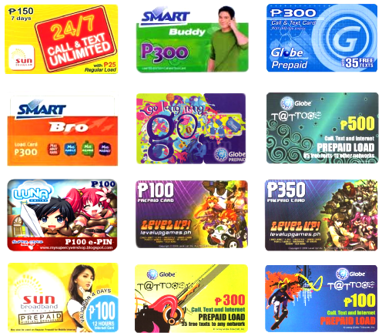
Internet Expense (Prepaid)
Maximum of 1,000 (per month)

Slide 14

Labor/ Pakyaw
(Labor cost of Repair and Provisions)
Not to exceed 2,000 (per laborer)

Slide 15



Daily Wage
(Cleaning, Grass Cutting, Pulling of Weeds, Laundry. Pruning of trees, etc.)
    Not to exceed 1500.00 per month

Slide 16


Repair Office/ICT Equipment and other Machineries
    Not to exceed 500.00 - per unit

Slide 17


Office Supplies
    Not to exceed 300.00 per month
    (Coupon Bond, Computer Ink, Folders, Ballpen)

Slide 18
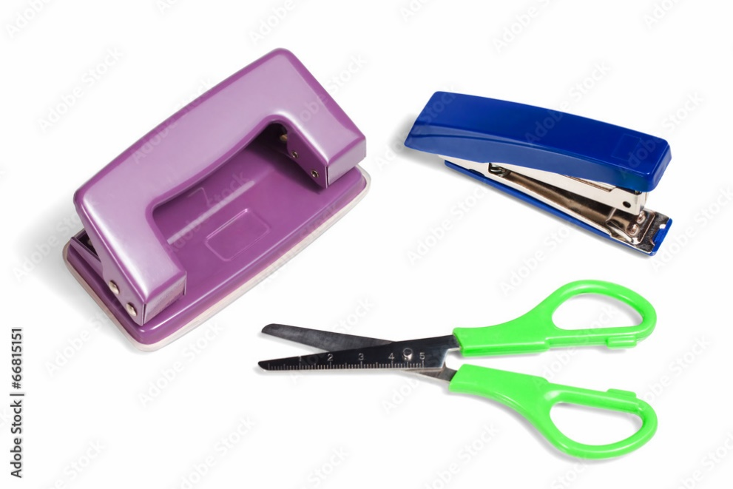
Semi Expendable Office Equipment
Not to exceed 300.00 per month
    (stapler, cutter, scissors, puncher)

Slide 19
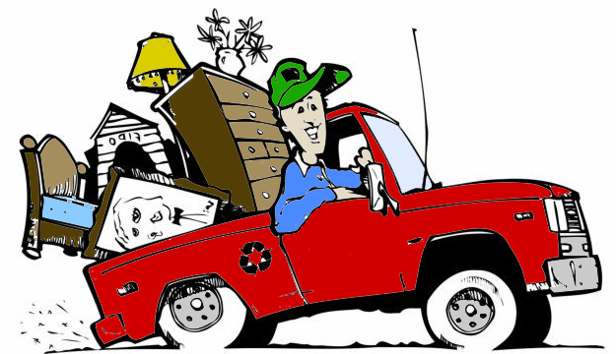
Hauling Expenses
not to exceed 1,500 per month

Slide 20

Printing and Publication
not to exceed 300.00 per month

Slide 21

Other Supplies and Materials Expense
Cleaning Supplies
not to exceed 300.00

Slide 22

Other Supplies and Materials Expense
Handwashing and Sanitation Supplies
not to exceed 300.00

Slide 23
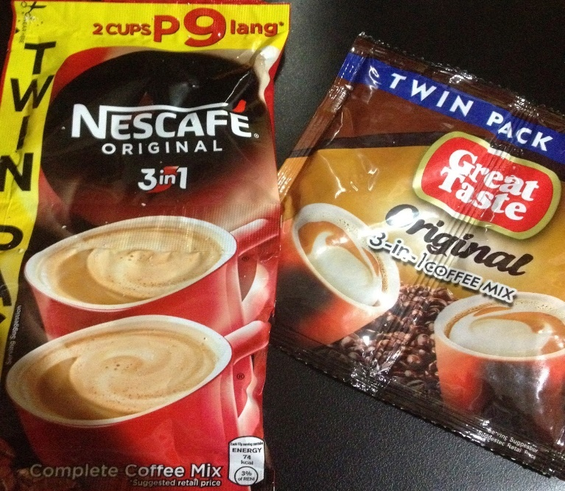
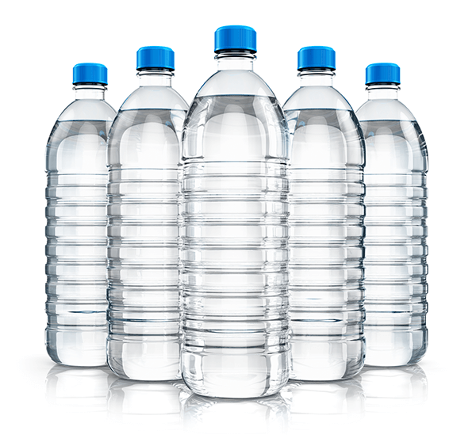
Other Supplies and Materials Expense
Groceries
      not to exceed 300.00

Slide 24

Other Supplies and Materials Expense
Tarpaulin and Streamer
not to exceed 300.00 per month

Slide 25


Other Supplies and Materials Expense
Purified Drinking Water
not to exceed 300.00 per month

Slide 26
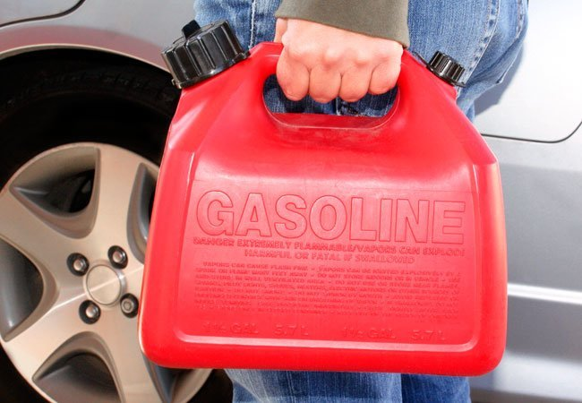
Other Supplies and Materials Expense
Gasoline
not to exceed 500.00 per month

Slide 27
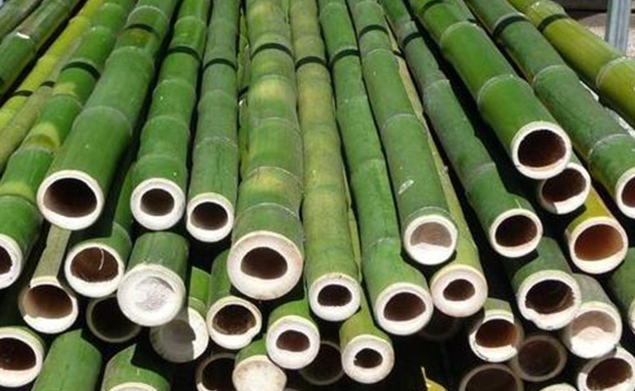
Bamboo/Pu-od
not to exceed 900.00

Slide 28
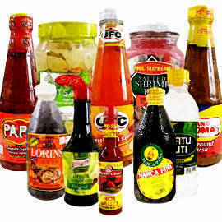
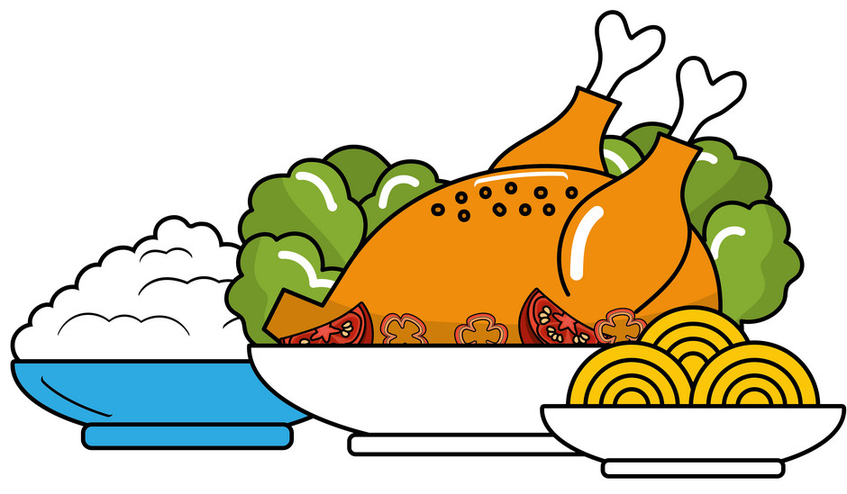
Other MOOE
Paluto (Labor/ingredients)
not to exceed 2,000
food for visitors
ingredients bought in market

Slide 29

Transportation Expenses
contest
immersion of students
athletes

Slide 30

Rental of Sound System (including operator) Per event
not to exceed 3,000 for central schools
not to exceed 1,500 non central schools

Slide 31

Construction Materials
not to exceed 300.00

Slide 32

For Reimbursement
(Any amount)

Slide 33


Travel Expenses
(School Heads, Teachers and Non Teaching Staff )

Slide 34

Training Expenses – Attending Training

Slide 35

Labor for Ribbon Making

Slide 36

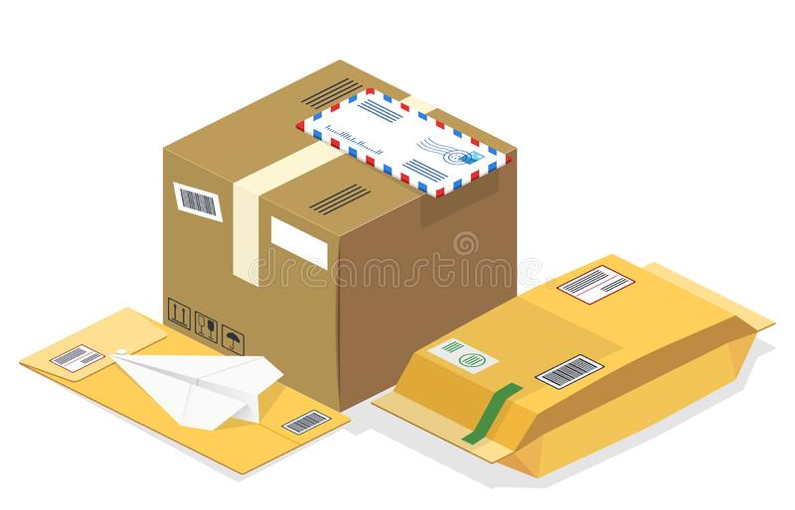
Postage & Courier

Slide 37
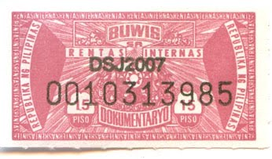
BIR Documentary Stamps

Slide 38

Electricity under BAPA

Slide 39
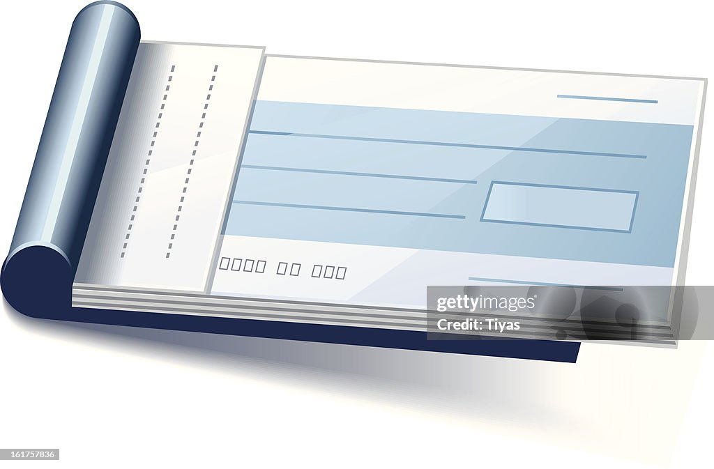
Check Booklet

Slide 40
Eligible Expenses | Maximum Allowable Amount
Janitorial/Security Expenses - per month | 3,000.00
Labor/ Pakyaw - per laborer Daily Wage- per month | 2,000.00 1,500.00
Internet Expense (Prepaid) - per month Repair ICT Equipment- per unit | 1,000.00 500.00
Office Supplies | 300.00
Other Supplies and Material Expenses | 300.00
Hauling | 1,500.00
Travel Expenses | -
Printing and Publication | 300.00
Tarpaulin and Streamer | 300.00
Paluto (Labor including ingredients) | 2,000.00

Slide 41
Eligible Expenses | Maximum Allowable Amount
Transportation Expenses (Pupils & Coaches) | -
Gasoline - per month Purified Drinking Water - per month Pu-od/Bamboo | 500.00 300.00 900.00
Rental of Sound System (with Operator) per event Non central Central | 1,500.00 3,000.00
Construction Materials | 300.00
Labor for ribbon making | Any Amount
Postage and Courier | Any Amount
BIR Documentary Stamps | Any Amount
Electricity (BAPA) | Any Amount
Check Booklet | Any amount

Slide 42
COMMOM ERRORS on the Reimbursement Summary REPORT

Slide 43

Reimbursement Summary Report for the month of January 2025
Check issued to: Marites Solsolera
Issued Date: January 31, 2025
Date | Name of Payee | Details | Account name | Account code | Amount
Jan.5, 2025 | ABC Printing Services | Payment for Tarpaulin | Other Supplies & Mat. Expense | 5020399000 | 350.00
Jan.10,2025 | OMG Gasoline Station | Gasoline | Other Supplies & Mat. Expense | 5020399000 | 950.00
Jan.15, 2025 | Len len Marcos | Daily Wage-Pahilamon | Other MOOE | 502999099 | 2500.00
Jan. 30, 2025 | Bong bong Piaya | Payment for Security for Jan.2024 | Security Expense | 5021203000 | 3500.00
TOTAL |  |  |  |  | 7, 300.00

Slide 44
Issued Date: February 18, 2022
Reimbursement Summary Report for the Month of February, 2022
Date | Name of Payee | Details | Account Name | Account Code | Amount
Jan.31, 2022 | CAPELCO | Payment for Electricity for January 2022 | Electricity Expense | 5020402000 | 958.68
February 3,2022 | XYZ Gadgets and Repair Services | Repair of Printers | Other MOOE | 5029990999 | 500.00
February 14, 2022 | Marissa Sanchez | Paluto | Other MOOE | 5029990999 | 2000.00
February 18,2022 | Isko Ako Manny Paaman Ping Pong | Labor-Repair of Fence | Other MOOE | 5029990999 | 8000.00
February 28,2022 | Renato Hipolito | Daily Wage-Gahit | Other MOOE | 5029990999 | 1000.00
TOTAL |  |  |  |  | 12, 458.68

Slide 45
Please take note!!!!
Reimbursement check should be issued last before liquidation to avoid underspent and overspent of fund.

Slide 46
-END OF PRESENTATION-

Slide 47
Thank You!
DIVISION ORIENTATION -WORKSHOP ON THE OPENING OF SCHOOLS’ BANK ACCOUNTS

